Slide 1
Supporting presentation for lecturers of Architecture/Civil Engineering
Chapter 08
Stainless Steel Surfaces

Slide 2
Contents
Stainless steel finishes
Tridimensional Surfaces
Woven meshes
References

Slide 3
1 - Stainless steel finishes ^{1,2}
Mill Finishes
Mechanically Polished andBrushed Finishes
Patterned Finishes
Bead Blasted Finishes
Electro-Polished Finishes
Coloured Finishes
Electrolytically Coloured Finishes
Electrolytically Coloured and Patterned Finishes
Organic Coatings
Specialist Decorative Finishes
Many finishes are available

Slide 4
Ex-mill cold rolled finishes ^{1,3}
EN 10088-2 cold rolled finishes from table 6 of the standard, with a guide to typical Ra values
Symbol | Finishing Process Route | Notes | Typical (Ra) μm
2B | Cold rolled, heat treated, pickled, skin passed | Most common 'cold rolled' finish available. Non-reflective, smooth finish, good flatness control. Thickness range limited by manufactures' skin passing rolling capacity. | 0.1-0.5
2C | Cold rolled, heat treated, not descaled | Smooth with scale from heat treatment, suitable for parts to be machined or descaled in subsequent production or where the parts are for heat resisting applications. | -
2D | Cold rolled, heat treated, pickled | Thicker sheet size ranges. Smoothness not as good as 2B, but adequate for most purposes. | 0.4-1.0
2E | Cold rolled, heat treated, mechanically descaled | Rough and dull. Usually applied to steels with a scale which is very resistant to pickling solutions | -
2H | Cold rolled, work hardened | "Temper" rolling on austenitic types improves mechanical strength. Smoothness similar to 2B | -
2R | Cold rolled, bright annealed | Highly reflective "mirror" finish, very smooth. Often supplied with plastic coatings for pressings. Manufactured items usually put into service without further finishing | .05-0.1
2Q | Cold rolled, hardened and tempered, scale free | Only available on martensitic types (e.g. 420). Scaling avoided by protective atmosphere heat treatment or descaling after heat treatment | -
More on Ra:
http://www.worldstainless.org/Files/issf/non-image-files/PDF/Euro_Inox/RoughnessMeasurement_EN.pdf
These are the most common ones

Slide 5



Most common mill finishes
 | 2B | This is produced as 2D, but a final light rolling using highly polished rolls gives the surface a smooth, reflective, grey sheen. This is the most widely used surface finish in use today and forms the basis for most polished and brushed finishes.
 | 2D | This is achieved by cold rolling, heat treating and pickling. The low reflective matt surface appearance is suitable for industrial and engineering needs but, architecturally, is suitable for less critical aesthetic applications.
 | 2R | By bright annealing under Oxygen-free atmosphetic conditions following cold rolling using polished rolls, a highly reflective finish, that will reflect clear images, is obtained. This ultra-smooth surface is less likely to harbour airborne contaminants or moisture than any other mill finish, and it is easy to clean.

Slide 6
Special Finishes ^{1,3}
EN 10088-2 special finishes from Table 6 of the standard, with a guide to typical Ra
Symbol | Finishing Process Route | Notes | Typical (Ra) μm
1G or 2G | Ground | Can be based on either '1' or '2' ex-mill finishes*. A unidirectional texture, not very reflective | -
1J or 2J | Brushed or dull polished | Can be based on either '1' or '2' ex-mill finishes*. Smoother than "G" with a unidirectional texture, not very reflective | 0.2-1.0
1K or 2K | Satin polished | Can be based on either '1' or '2' ex-mill finishes*. Smoothest of the special non-reflective finishes with corrosion resistance suitable for most external applications. | < 0.5
1P or 2P | Bright polished | Can be based on either '1' or '2' ex-mill finishes*. Mechanically polished reflective finish. Can be a mirror finish. | < 0.1
2F | Cold rolled, heat treated, skin passed on roughened rolls | Uniform non-reflective matt surface, can be based on either 2B or 2R mill finishes | -
1M or 2M | Patterned | Can be based on either '1' or '2' ex-mill finishes*. One side patterned only. Includes "chequer" plates ("1" ex-mill finish) & fine textures finishes ("2" ex-mill finish) | -
2W | Corrugated | Profile rolled (e.g. trapezoidal or sinusoidal shapes) | -
2L | Coloured | Applied to flat (2R, 2P or 2K type fishes) or patterned (2M) sheet base finishes in a range of colours | -
1S or 2S | Surface coated | Can be based on either '1' or '2' ex-mill finishes . Normally coated on one side only with a metallic coating, such as tin, aluminium or titanium | -
There is a very wide choice of special finishes
* 1 finishes are for hot-rolled products, 2 finishes for cold rolled

Slide 7
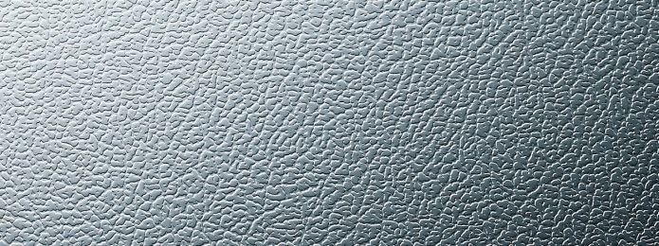
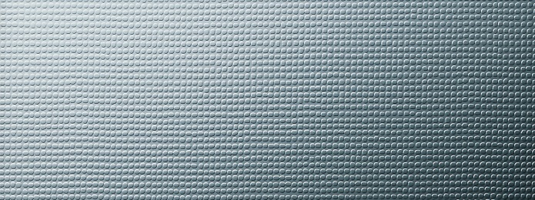
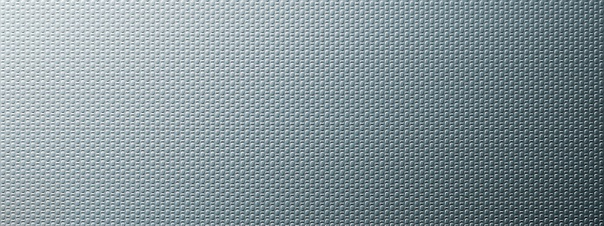
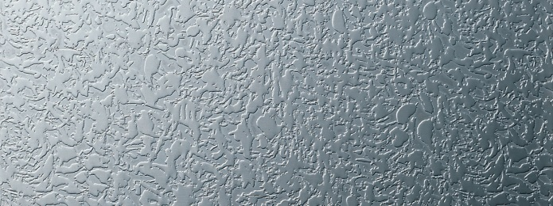
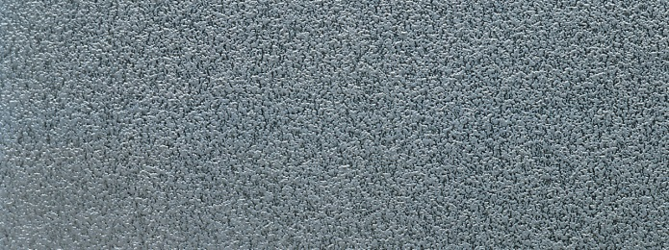
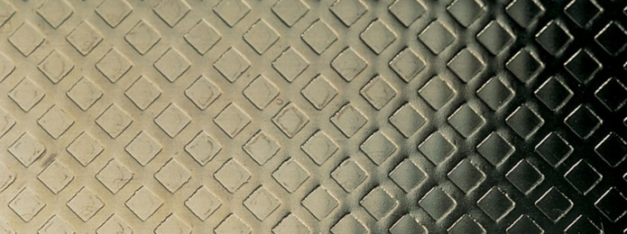
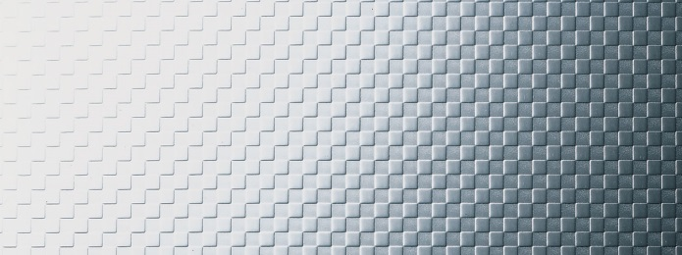
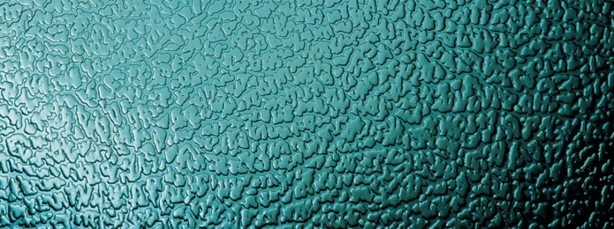
Patterned Finishes ^{4,5,7}
These few examples illustrate the use of sheets patterned on one side only, classified as 2M. A wide variety of patterns are available

Slide 8
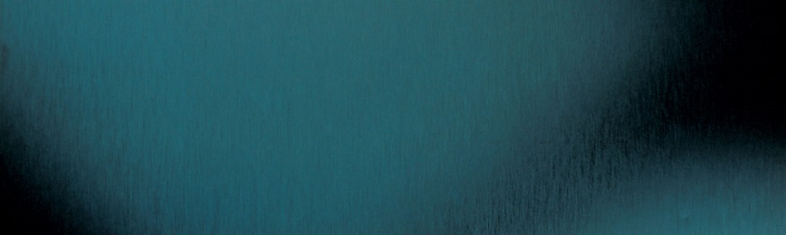
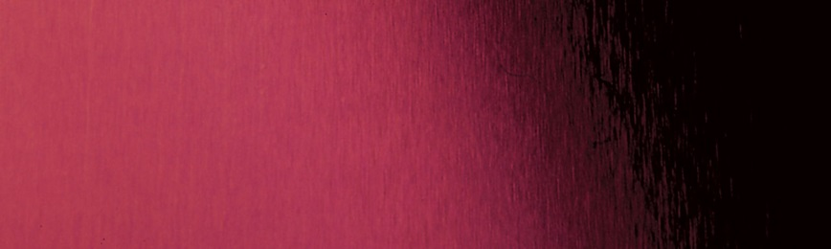

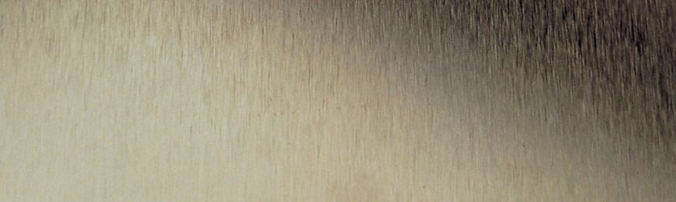
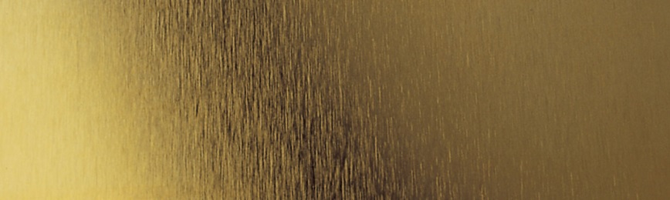
Coloured finishes^{4, 5,7}
This is only a selection of the colour effects that can be produced by electrolytically colouring stainless steel

Slide 9
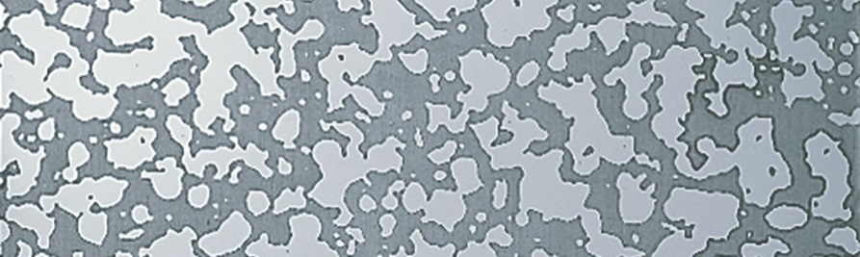
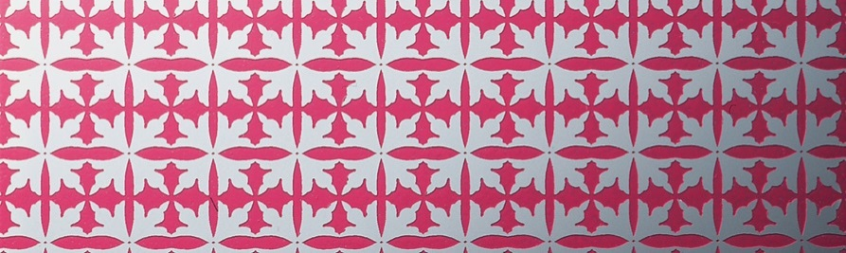
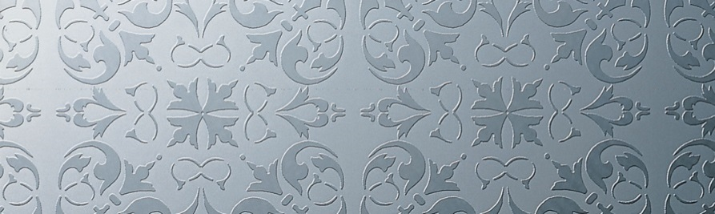
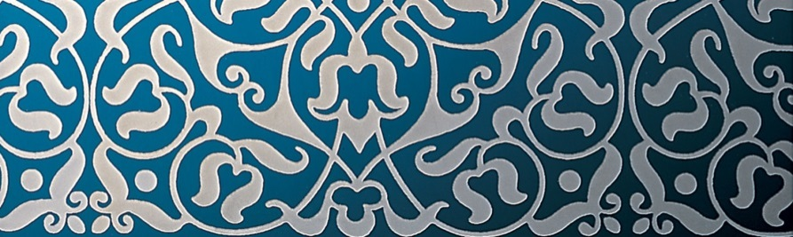
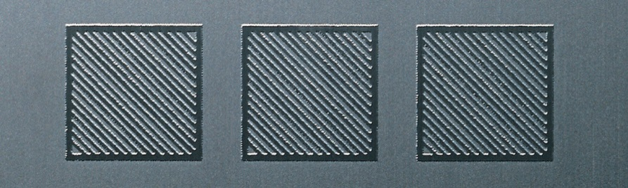
Etched Patterns^{4,5,7}
Silk screen and photoresist processes have been developed to transfer any pattern onto stainless steel, the surface of which is then acid etched to reveal the pattern. Acid etching is a process which removes a small amount of surface material. Etched surfaces have a dull and a slightly coarse appearance which contrast well with polished or satin finished un-etched surfaces. Electro-chemical colour can be given to etched surfaces before or after etching.

Slide 10
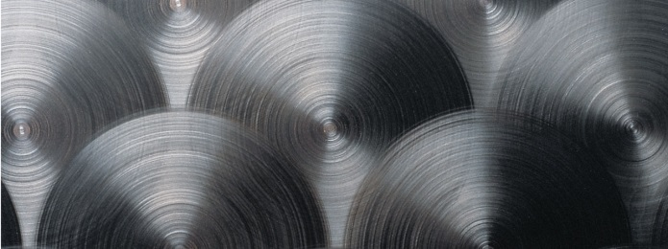
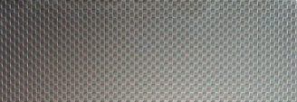
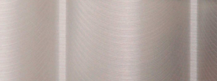
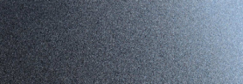
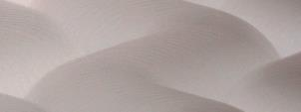
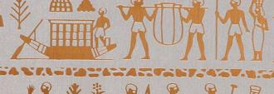
Proprietary finishes ^{4,5}
Many specific & custom finishes are available from specialized companies
Some examples are shown below

Slide 11
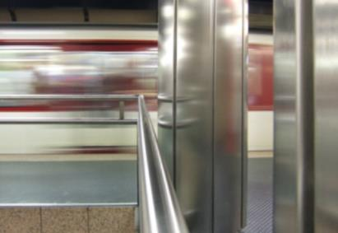
Electropolishing ⁶
Produces bright reflecting surfaces which feature
Optimum corrosion resistance for any grade
Easier disinfection and cleanability
Easier removal of graffiti
However
Irregular surfaces are more visible
As well as damage from scratches and mechanical damage

Slide 12

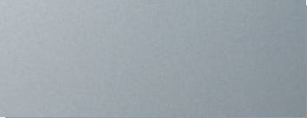
Bead Blasting ⁸
The appearance can be altered by different blasting materials, e.g. glass bead (above) or shredded glass (below)

Slide 13
Please note:
There are many different grades of stainless steel, which offer solutions to a wide range of design problems, from corrosion resistance in even the most aggressive environments, to high strength requirements; and from ease of formability to ease of welding. Similarly, stainless steels offer a wide range of surface finishes which can assist the architect in achieving the aesthetically pleasing appearance he is looking for. Surface finishes range from a plain matte through soft polishing through textured patterns and colours right up to highly polished mirror finishes. These provide the imaginative designer with a wide array of options.
Care should be taken when using glossy surface finishes to ensure that they do not unwittingly create glare or heat reflectivity issues. Especially building fronts facing the sun and concave-shaped areas deserve special attention during the planning phase.

Slide 14
Architects use everyday the palette of surface finishes available on stainless steels ⁷
In Chapter 2 you will find some examples of buildings for which the surface finish is essential to the aesthetics

Slide 15
2 - Tridimensional Finishes ⁹
i.e. deeper tridimensional features than patterns obtained by embossing, punching, cuttting, profiling, ….
usually carried out on Computer-controlled machines

Slide 16
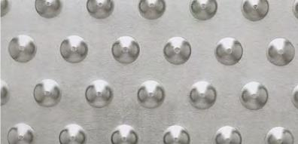
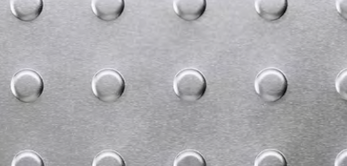
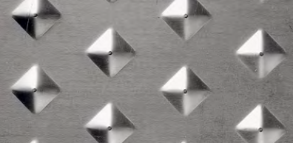
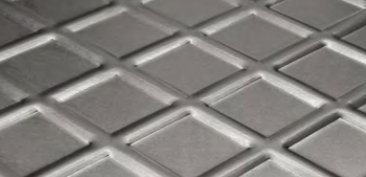
Embossed patterns ⁹

Slide 17
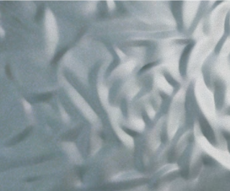
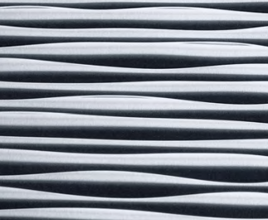
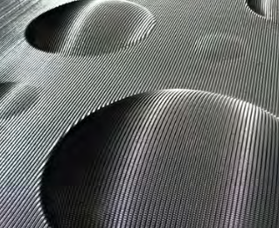
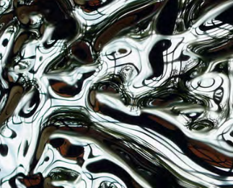
Irregular shapes⁹ (fluid forming)

Slide 18
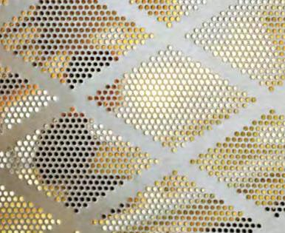
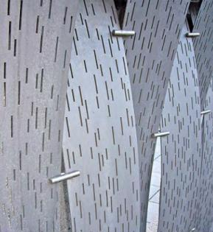
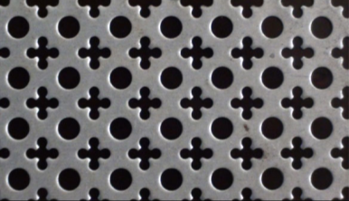
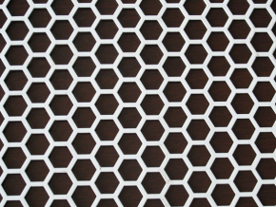
Perforated sheet ⁹

Slide 19
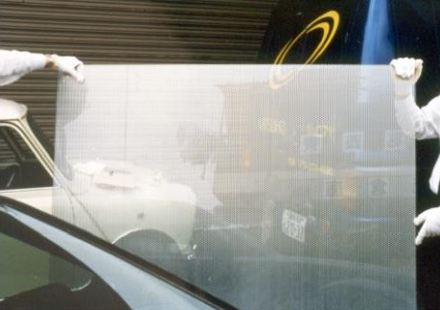
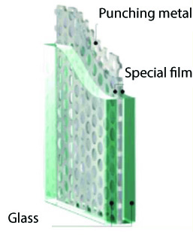
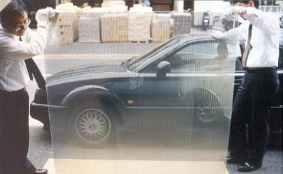
Semi-transparent glass panels with perforated sheet ¹⁰

Slide 20
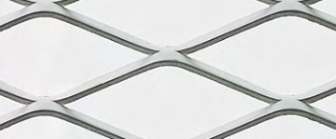
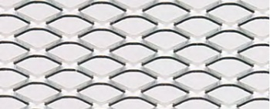
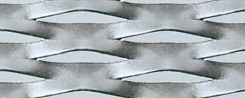
Expanded Sheet

Slide 21
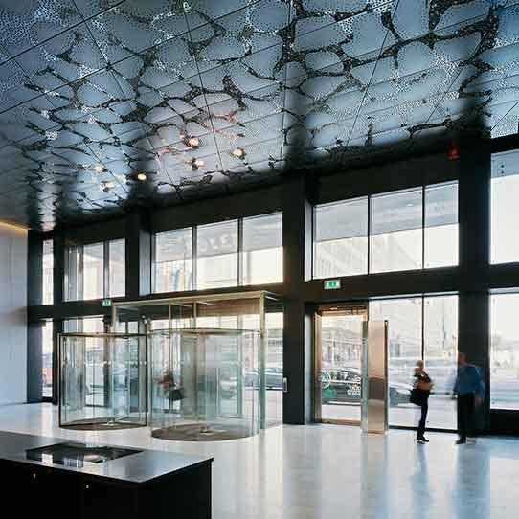
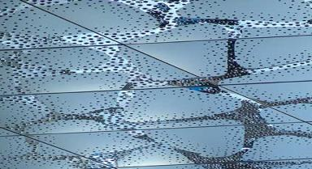
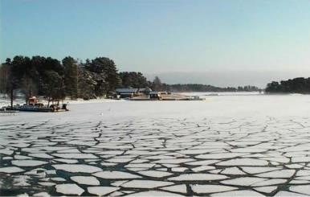
Combination of techniques ¹¹
Stockholm Waterfront Building : Perforated and colored stainless steel ceiling that reproduces the image of the melting ice on the lower right

Slide 22
3 – Woven Mesh

Slide 23
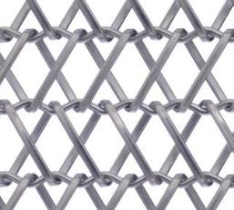
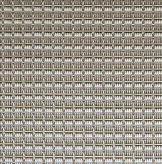
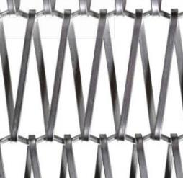
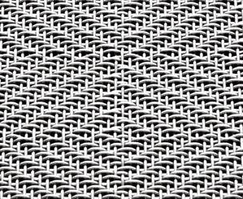
Standard ¹²⁻¹⁴
A very wide set of woven shapes and patterns is available, with adjustable
stiffness
open area
light diffusion
acoustic transparency
color
etc…

Slide 24

Example of decoration with stainless steel mesh

Slide 25

Outside decoration with Stainless Wire mesh
Stainless wire mesh is widely used for decoration. It allows special effects such as lights (with LEDs) as shown (Swarovski Building headquarters)

Slide 26


Woven stainless with LEDs ¹³

Slide 27
4 - References and sources
https://www.worldstainless.org/Files/issf/non-image-files/PDF/Euro_Inox/Finishes02_EN.pdf
http://www.ssina.com/download_a_file/special_finishes.pdf
http://www.bssa.org.uk/topics.php?article=47
www.uginox.com/sites/default/files/public/Triptyque%20Lusignan_web.pdf
http://www.poligrat.de/home/
https://www.worldstainless.org/Files/issf/non-image-files/PDF/Euro_Inox/Electropolishing_EN.pdf
http://www.legrand-sgm.fr/
https://www.worldstainless.org/Files/issf/non-image-files/PDF/Euro_Inox/3D_Finishes_EN.pdf
https://cambridgearchitectural.com/projects/ft-lauderdale-hollywood-international-airport-rental-car-center
https://www.exyd.com/waterfront-building.html
http://cambridgearchitectural.com
https://gkd.de/architekturgewebe/
http://www.diedrahtweber-architektur.com/de/anwendungen-architekturgewebe/medienfassade/
https://www.worldstainless.org/Files/issf/non-image-files/PDF/Euro_Inox/RoughnessMeasurement_EN.pdf

Slide 28
Thank you
Test your knowledge of stainless steel here:
https://www.surveymonkey.com/r/3BVK2X6

