Slide 1
Supporting presentation for lecturers of Architecture/Civil Engineering
Chapter 04
What are the stainless steels?

Slide 2
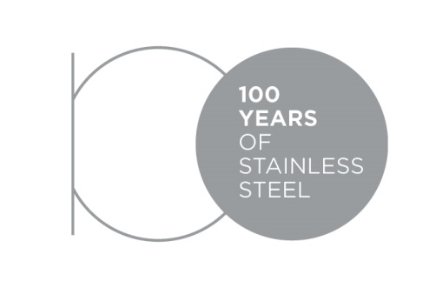
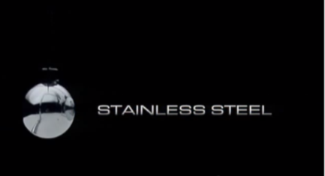
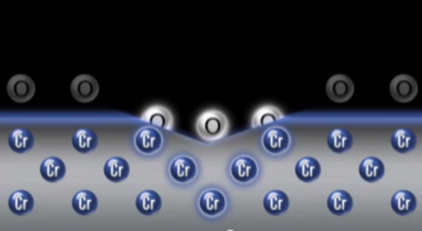
Videos
 | 100 Years of Stainless Steel https://youtu.be/E-GcuxtWcnc
 | Alloyed for Lasting Value https://youtu.be/l4Z1UVWm3DE
 | Self-repairing for Lasting Value https://youtu.be/ngnT6dYo-M0

Slide 3
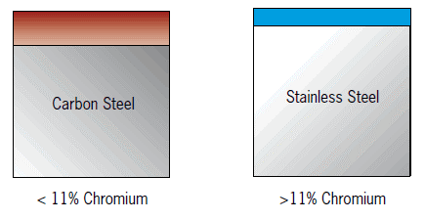
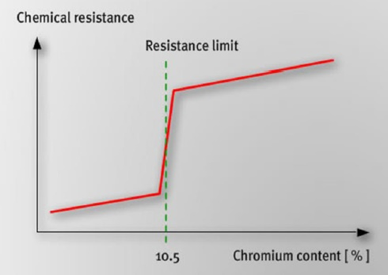
Stainless steels are Iron-base alloys containing at least 10.5% chromium
Surface Oxide (rust) > 20μm thick
Surface Passive film
~ 2nm thick
corrosion resistance
The passive film forms in a few minutes
Increasing Cr content increases the effectiveness of the passive film… but there are other important factors that influence the corrosion resistance
(see Chapter 5)

Slide 4
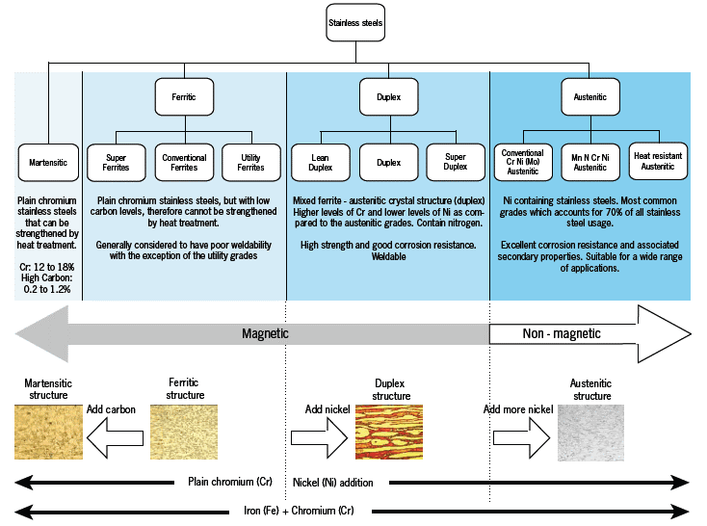

10-17%Cr
0.1-1.2%C
0-4%Ni

Slide 5
Cr-Ni Grades (Austenitics)⁴
Sub-groups:
Cr-Ni | Typically EN 1.4301/AISI 304 | Cr: 18 | Ni: 9 |  | Fe: Balance
Cr-Ni-Mo | Typically EN 1.4401/AISI 316 | Cr: 18 | Ni 10 | Mo: 2.5 | Fe: Balance
Common Properties:
Very good corrosion resistance, increases with alloy content
... but can be susceptible to SCC in hot chloride environment (e.g. swimming pools)
High ductility and impact resistance at all (including very low) temperatures
Strength can be increased by cold working (but not by heat treatment)
Very good fire resistance
Very good cold and hot forming properties (ductility, elongation)
Easy to weld (TIG, MIG)
The best known and still the most used today
Colour code: | Corrosion resistance | Mechanical properties | Fabrication

Slide 6
Cr-Mn Grades (Austenitics with Manganese)⁵
Typical grade:
Cr-Mn-Ni-N | Typically EN 1.4372/AISI 201 | Cr: 17 | Mn: 7 | Ni: 4 | N:0.15 | Fe: Balance
Common Properties:
Lesser corrosion resistance
... but far more susceptible to SCC and to pitting, particularly at low Ni and Cr levels
Higher strength
Poor cold forming properties due to high work-hardening
Poor machinability
More difficult to weld
Cost less than Cr-Ni Austenitics ... but more than Cr ferritics
Used mostly in India and China
Colour code: | Corrosion resistance | Mechanical properties | Fabrication

Slide 7
Cr Grades (Ferritics)⁶
Sub-groups:
Cr | Typically EN 1.4016/AISI 430 | Cr: 17 |  |  |  | Fe: Balance
Cr-Mo | Typically EN1.4521/AISI 444 | Cr: 18 | Mo: 2 | Ti+Ni: 0.4 |  | Fe: Balance
Common Properties:
Insensitive to Stress Corrosion Cracking
Good ductility (lower than austenitic grades, though)
Not suitable for use at very low temperatures
Strength can be somewhat increased by cold working (but not by heat treatment)
Very good cold forming properties: (less springback, lower tool wear but lower elongation requires a different deep drawing process compared to austenitics)
Stabilized grades (i.e. with Nb and/or Ti) are easy to weld (TIG, MIG)
Offer an optimum performance/cost for many applications and are increasingly used
Colour code: | Corrosion resistance | Mechanical properties | Fabrication

Slide 8
Cr Grades (Martensitics)⁷
Sub-groups:
C-Cr | Typically EN1.4021/AISI 420 | Cr: 13 | C:0.2 |  | Fe: Balance
C-Cr-Ni | Typically EN1.4057/AISI431 | Cr: 16 | Ni: 2 | C: 0.2 | Fe: Balance
Precipitation Hardening | Typically EN1.4542/AISI630 | Cr: 17 | Ni: 4 | Cu:4 | Fe: Balance
Common Properties:
Fair to good corrosion resistance, increases with alloy content
High strength obtained by heat treatment (not by cold work). Limited elongation.
Not suitable for use at very low temperatures
Not suitable for forming, often processed by machining
Can be welded (TIG, MIG), but require usually post-weld heat
treatment
Are used as engineering steels with corrosion resistance
Colour code: | Corrosion resistance | Mechanical properties | Fabrication

Slide 9
Duplex (Austenitic-Ferritic)⁸
Sub-groups:
Cr-Ni | Typically EN1.4362 | Cr: 23 | Ni: 4 |  | Fe: Balance
Cr-Ni-Mo | Typically EN1.4462 | Cr: 22 | Ni: 5 | Mo: 3 | Fe: Balance
Common Properties:
Excellent corrosion resistance, increases with alloy content
Insensitive to Stress Corrosion Cracking
High strength, good ductility
Strength can be increased by cold working (but not by heat treatment)
Good cold and hot forming properties (ductility, elongation)
Weldable (TIG, MIG)
Offer the best combination of corrosion resistance and mechanical properties
Colour code: | Corrosion resistance | Mechanical properties | Fabrication

Slide 10
Physical properties^{9, 10}
Materials | Modulus of Elasticity Gpa | Thermal Expansion Coefficient 10⁻⁶°K-1 | Thermal Conductivity W m⁻¹°K⁻¹ | Ferro-Magnetism | Density Kg/dm³
Cr-Ni Austenitics | 210 | 18 | 15 | No | 7.8
Cr-Mn Austenitics | 210 | 17 | 15 | No | 7.8
Cr Ferritics | 220 | 11 | 23 | Yes | 7.7
Cr-Ni (Mo)-N Duplex | 210 | 14 | 15 | Intermediate | 7.8
Cr-C Martensitics | 215 | 11 | 30 | Yes | 7.7
Carbon Steel | 210 | 12 | 18 | Yes | 7.8
Copper | 135 | 17 | 380 | No | 8.3
Aluminum | 70 | 22 | 230 | No | 2.7
Glass | 65 | 9 | 1,7 | No | 2.5
Concrete | 48 | 10 | 1 | No | 2.5

Slide 11




Standards on Stainless Steels
Main World Standards:
ISO | EN | ASTM/AISI | UNS | JIS
Notes: Most countries refer to the above standards, which are widely accepted. A lot of the grades are very similar in all of the above standards. List of the American Standards: ref 11 List of European Standards: ref 12 Correspondance tables are available: refs 13 - 15

Slide 12
Main grades in Architecture Building and Construction:
EN 10088-4 (for sheet/plate/strip)^{16, 17}
Grade | ASTM UNS | C Wt% | Cr Wt% | Ni Wt% | Mo Wt% | Other Wt% | Typical use ^{3,4}
4003 | S40977 | 0,02 | 11,5 | 0,5 | - | - | heated and unheated interiors
4016 | 430 | 0,04 | 16,5 | - | - | - | decorative interior cladding
4509 4510 | S43932 439 | 0,02 0,02 | 18 17 | - - | - - | Nb Ti Ti | inland roofing and rainwater goods - often Tin-coated for patina
4521 | 444 | 0,02 | 17,8 | - | 2,1 | Ti | domestic plumbing market
4301 4307 4306 | 304 304L 304L | 0,04 0,02 0,02 | 18,118,118,2 | 8,1 8,1 10,1 | - - - | - - - | building interiors and exteriors in normal industrial atmospheres away from the coast
4401 4404 4571 | 316 316L 316Ti | 0,04 0,02 0,04 | 17,2 17,2 16,8 | 10,1 10,1 10,9 | 2,1 2,1 2,1 | - - Ti | permanently wet applications, locations in a coastal atmosphere, polluted industrial atmospheres or near roads where de-icing salts can be an issue
4529 4547 | N08926 S31254 | 0,01 0,01 | 20,5 20,0 | 24,8 18,0 | 6,5 6,1 | N, Cu N, Cu | road tunnels and indoor swimming pools
ABC = Architecture, Building and Construction

Slide 13
Main grades in Architecture Building and Construction:
EN 10088-5(for bars/wires/sections)¹⁸
Grade | ASTM UNS | C Wt% | Cr Wt% | Ni Wt% | Mo Wt% | Other Wt% | Typical use ⁶
4003 | S40977 | 0,02 | 11,5 | 0,5 | - | -
4016 | 430 | 0,04 | 16,5 | - | - | - | Slate hooks
4542 | 630 | 0,04 | 16,0 | 4,0 |  | Cu,Nb | Tie bars
4301 4307 4311 4567 | 304 304L 304N 304Cu | 0,04 0,02 0,02 0,02 | 18,1 18,1 18,1 17,1 | 8,1 8,1 8,6 8,6 | - - - - | - - N Cu | Rebar A2 fasteners
4401 4404 4429 | 316 316L « 316LN » | 0,05 0,02 0,02 | 16,6 16,6 16,6 | 10,1 10,1 11,1 | 2,1 2,1 2,6 | - - N | Building interiors and exteriors in normal industrial atmospheres away from the coast, Rebar
4529 4547 | « 926 » S31254 | 0,01 0,01 | 20,5 20,0 | 24,8 18,0 | 6,5 6,1 | N, Cu N, Cu | Road tunnels and indoor swimming pools
4362 | S32304 | 0,02 | 22,5 | 3,6 | 0,3 | N, Cu | Rebar and mechanical components
4462 | S32205 | 0,02 | 21,5 | 4,6 | 2,8 | N | Rebar and mechanical components

Slide 14

Breakdown of the stainless steel production worldwide by family

Slide 15
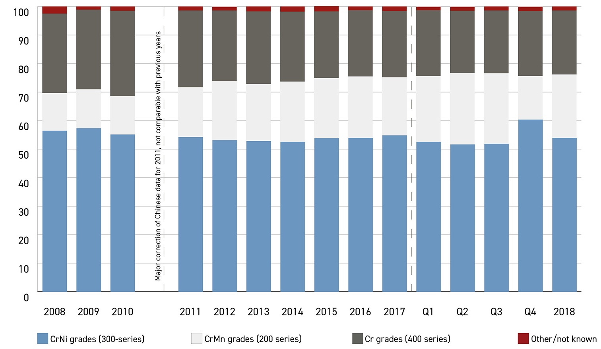
Breakdown of the world production by family¹⁹
High Ni prices favour the replacement of popular CrNi grades by Cr-Mn or Cr Grades
Duplex grades marginal today, are expected to grow in the future

Slide 16
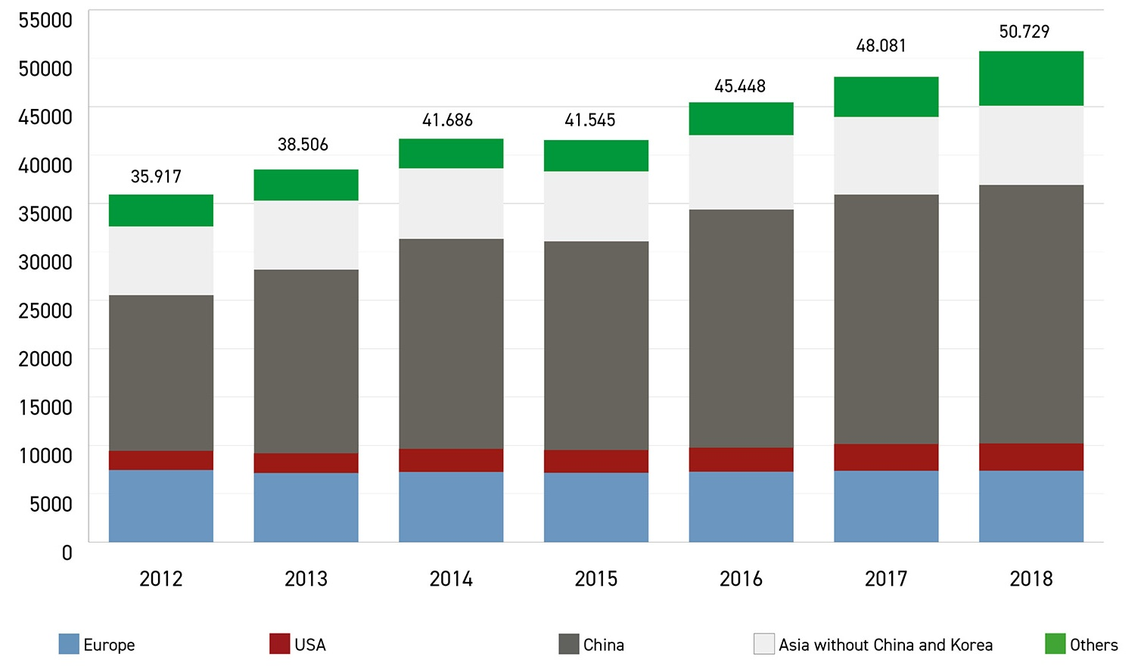
World stainless meltshop production
(slab/ingot equivalent)
UPDATED 2019!

Slide 17
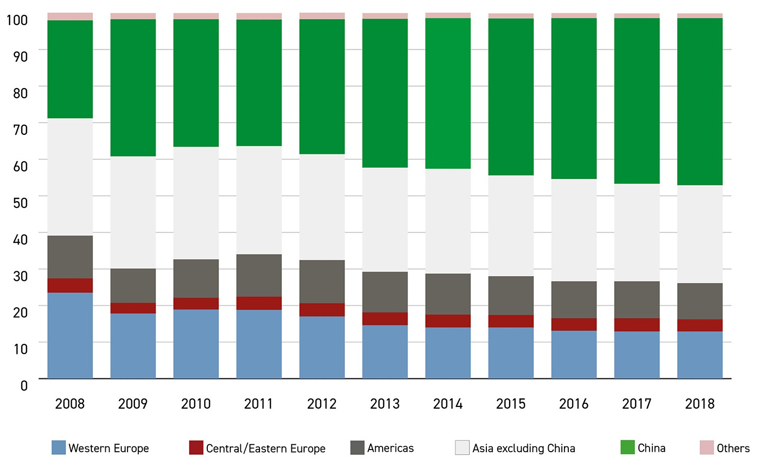
Apparent stainless use by region

Slide 18
References (1/2)
http://www.worldstainless.org/Files/issf/non-image-files/PDF/TheStainlessSteelFamily.pdf
D. Peckner Handbook of Stainless Steels Hardcover – June, 1977 ISBN-13: 978-0070491472 ISBN-10: 007049147X
http://www.imoa.info/download_files/stainless-steel/Austenitics.pdf
New « 200 series steels »: An opportunity or a threat to the image of stainless steel? https://www.worldstainless.org/Files/issf/non-image-files/PDF/ISSFNew200seriessteelsAnopportunityorathreat_EN.pdf
The ferritic solution: https://www.worldstainless.org/Files/issf/non-image-files/PDF/ISSF_The_Ferritic_Solution_Italian.pdf
http://www.outokumpu.com/en/stainless-steel/about-stainless-steel/stainless-steel-types/pages/default.aspx
Martensitic stainless steels https://www.worldstainless.org/Files/issf/non-image-files/PDF/ISSF_Martensitic_Stainless_Steels.pdf
Duplex stainless steels: https://www.imoa.info/molybdenum-uses/molybdenum-grade-stainless-steels/architecture/structural-duplex-stainless.php?d=1
https://www.nickelinstitute.org/~/Media/Files/TechnicalLiterature/CapabilitiesandLimitationsofArchitecturalMetalsandMetalsforCorrosionResistanceI_14057a_.pdf
https://www.worldstainless.org/Files/issf/non-image-files/PDF/Euro_Inox/Tables_TechnicalProperties_EN.pdf
http://www.imoa.info/download_files/stainless-steel/2014-8-Specification-and-Guideline-list.pdf
http://www.bssa.org.uk/topics.php?article=370&featured=1
https://www.worldstainless.org/about-stainless/what-is-stainless-steel/standards/

Slide 19
References (2/2)
Chemical composition of stainless steel flat products for general purposes to EN 10088-2: http://www.bssa.org.uk/topics.php?article=44
Chemical composition of stainless steel long products for general purposes to EN 10088-3: http://www.bssa.org.uk/topics.php?article=46
EN 10088-4:2009 Stainless steels. Technical delivery conditions for sheet/plate and strip of corrosion resisting steels for construction purposes www.worldstainless.org/Files/issf/non-image-files/PDF/Euro_Inox/EN10088-4_EN.pdf
Stainless steel flat products for building – the grades in EN 10088-4 explained: https://www.worldstainless.org/files/issf/non-image-files/PDF/Euro_Inox/EN10088-4_EN.pdf
EN 10088-5: 2009 Stainless steels. Technical delivery conditions for bars, rods, wire, sections and bright products of corrosion resisting steels for construction purposes.
ISSF publication « Stainless Steel in Figures »: https://www.worldstainless.org/Files/issf/non-image-files/PDF/ISSF_Stainless_Steel_in_Figures_2019_English_public_version.pdf

Slide 20
Thank you!
Test your knowledge of stainless steel here:
https://www.surveymonkey.com/r/3BVK2X6

