Slide 1
Supporting presentation for lecturers of Architecture/Civil Engineering
Chapter 03
Why stainless steels?

Slide 2
Introduction
Main materials used in architecture, building and construction

Slide 3
Relative use of the main building materials today
UPDATED 2019!
Materials | World Production * | Average Density | Remarks
Rammed earth, pisé | na |  | Was used for traditional houses in Africa mostly. Some renewed interest for its environmental properties
Bricks ² Traditional production is very polluting and unhealthy | 4185 | 2,0 | Year 2017 Of which 87% in Asia
Cement ³ | 3545 | 2,4** | (To obtain the figure for concrete multiply by 3-4) **Concrete density - 2018 figures
Steel ^{4a} | 1690 | 7,8 | (Crude Steel production 2018) –Includes stainless steel 14% goes into infrastructures - half as rebar ¹⁰ 42% goes into buildings ¹²
Cast Iron and Steel^{4b} | 110 | 7,8 | 2017 Figures
Wood ⁵ Deforestation keeps gaining ground | 887 | 0,56 | Sawn wood+wood-based panels only (2016 figures) Excluding pulpwood (about 656) Excluding wood fuel (1860) & other wood products
Man-Made Polymers ⁶ | 348 | 1,1 | Some Natural Polymers: Cellulose, Rubber, Silk, Chitin 2017 figures
Man-made Glass ⁷ | 75 | 2,6 | Flat glass only (80% of total glass market) 2018 figures Main other markets: Automotive, Solar energy Glass
Aluminum ⁸ | 64 | 2,7 | (Primary Aluminum Production in 2018) 24% goes into construction ¹⁰
Stainless Steel ⁹ | 51 | 7,8 | 2018 figures 17% goes into construction ¹¹
na: not available
* in Millions Metric Tons

Slide 4
Relative use of the main building materials today:
Bar Chart
UPDATED 2019!
Millions Tonnes (year: 2014)

Slide 5
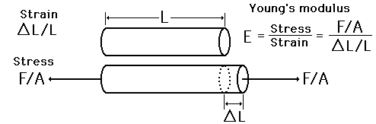
Young’s modulus E of various materials¹² (stiffness )
Material | Young’s Modulus E (GPa)
Steels | ~210
Stainless steels | ~210
Copper alloys | ~130
Titanium Alloys | ~100
Aluminum alloys | ~70
Concrete | ~40
Wood | ~10
Plastics | ~4
Stainless steels are as stiff as steel

Slide 6
Strength/weight ratio¹³ of architectural metals
Stainless steels offer a strength/weight ratio comparable to steels and to Al alloys
Material | Strength (YS)/Specific Weight | Yield, Stress, Mpa | Ultimate Tensile Strength, Mpa | Specific wt (Kg/dm³) | Min Elongation, %
Stainless 304 or 316, annealed | 26 | 205 | 515 | 7,8 | 35
Stainless 304 or 316, work-hardened CP 350 | 45 | 350 | - | 7,8 | -
Stainless 304 or 316, work-hardened CP 500 | 62 | 480 | - | 7,8 | -
Duplex 2205 | 64 | 500 | 700/950 | 7,8 | 20
Stainless 630, aged | 103 | 800 | 950/1150 | 7,8 | 10
C-steel commercial sheet, Hot rolled | 30 | 234 | 317 | 7,8 | 35
Structural Steel (plate and bar) | 32 | 250 | 400/550 | 7,8 | 23
HSLA Steel | 49 | 380 | 460 | 7,8 | 25
Engineering Steel 4140 Q&T | 96 | 750 | 930/1080 | 7,8 | 12
Aluminum Alloy 3003- H14 | 37 | 145 | 150 | 2,7 | 40
Aluminum Alloy 3105- H14 | 38 | 150 | 170 | 2,7 | 5
Aluminum Alloy 5005- H16 | 44 | 170 | 180 | 2,7 | 5
Aluminum Alloy 6061- T6 | 71 | 275 | 310 | 2,7 | 12
Aluminum Alloy 6063- T5 | 37 | 145 | 185 | 2,7 | 12
Copper | 23 | 195 | 250 | 8,3 | 30

Slide 7
Simplified overview of different materials¹⁴
 |  | Stainless Steels |  |  | Copper | Aluminum | Carbon Steel | Plastics
 | Properties | EN 1.4521 AISI 444 | EN 1.4301 AISI 304 | EN 1.44O1 AISI 316
Physical | Density | - | - | - | - - | + | - | + +
 | Linear expansion | + + | 0 | 0 | 0 | - | + | - -
 | Electrical Conductivity | - - | - | - | + + + | + + | 0 | - - -
 | Ferromagnetism | YES | NO | NO | NO | NO | YES | NO
Mechanical | Stiffness (Young’s modulus) | + + + | + + + | + + + | + | - | + + + | - - -
 | Tensile | + | + + | + + | 0 | - | + / + + | - -
 | Elongation | + | + + + | + + + | + + + | + + | 0 | - - / + + +
Other | Fabrication | + + | + + | + + | + | 0 | + + | -
 | High temperatures | + + | + + | + + + | 0 | - | + | - - -
 | Low temperatures | - | + + + | + + + | + | 0 | - | -
 | Corrosion resistance | + + + | + + + | + + + + | + + | + | - - | +
Symbols + Advantage - Weakness (relative to the other materials)

Slide 8
Stainless steel remains a « young » material

Slide 9
New materials have appeared in the course of history
Stainless steel is the most recent*
Materials | Timeframe
Rammed earth, pisé |  | Has been used since the dawn of mankind!
Wood ¹⁵ |  | Has been used since the dawn of mankind!
Brick ¹⁵ | 7500 BC 4500 BC | Fired bricks/ceramics
Steel ¹⁵ | 4000 BC 1858 | Blacksmiths’ shops Bessemer Process
Man-made Glass ¹⁵ | 3500 BC 100 BC 1950 | First glassmaking Clear Glass Pilkington (Float Glass) Process
Aluminum ¹⁵ | 1825 1886 | Oersted discovers Aluminum The Hall –Heroult process
Reinforced Concrete ¹⁵ | 1850 1885 | But cement is much older Rotary Kiln Process
Man-Made Polymers ¹⁵ | 1846 1907 1939 | Celluloïd Bakelite Nylon
Stainless Steel ² | 1912-1913 1954 1955 | Early alloys AOD Process Hot Strip Rolling
* There are newer materials, of course, but not used in significant quantities
Notes:
Stainless steel is a « recent » material

Slide 10
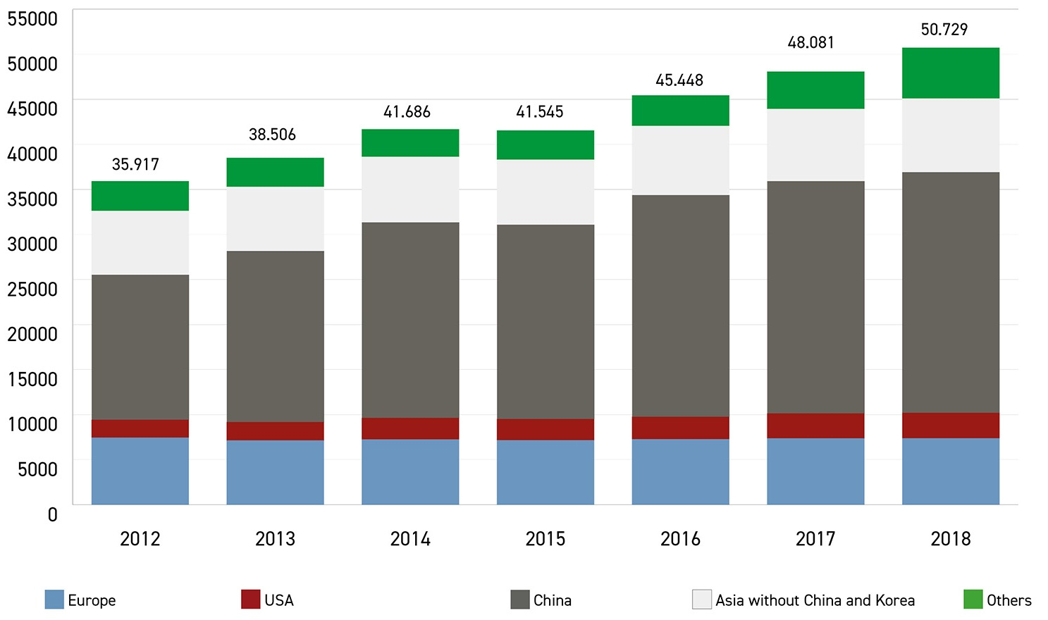
World Stainless Steel Production by area ²²
UPDATED 2019!
Demand keeps growing

Slide 11
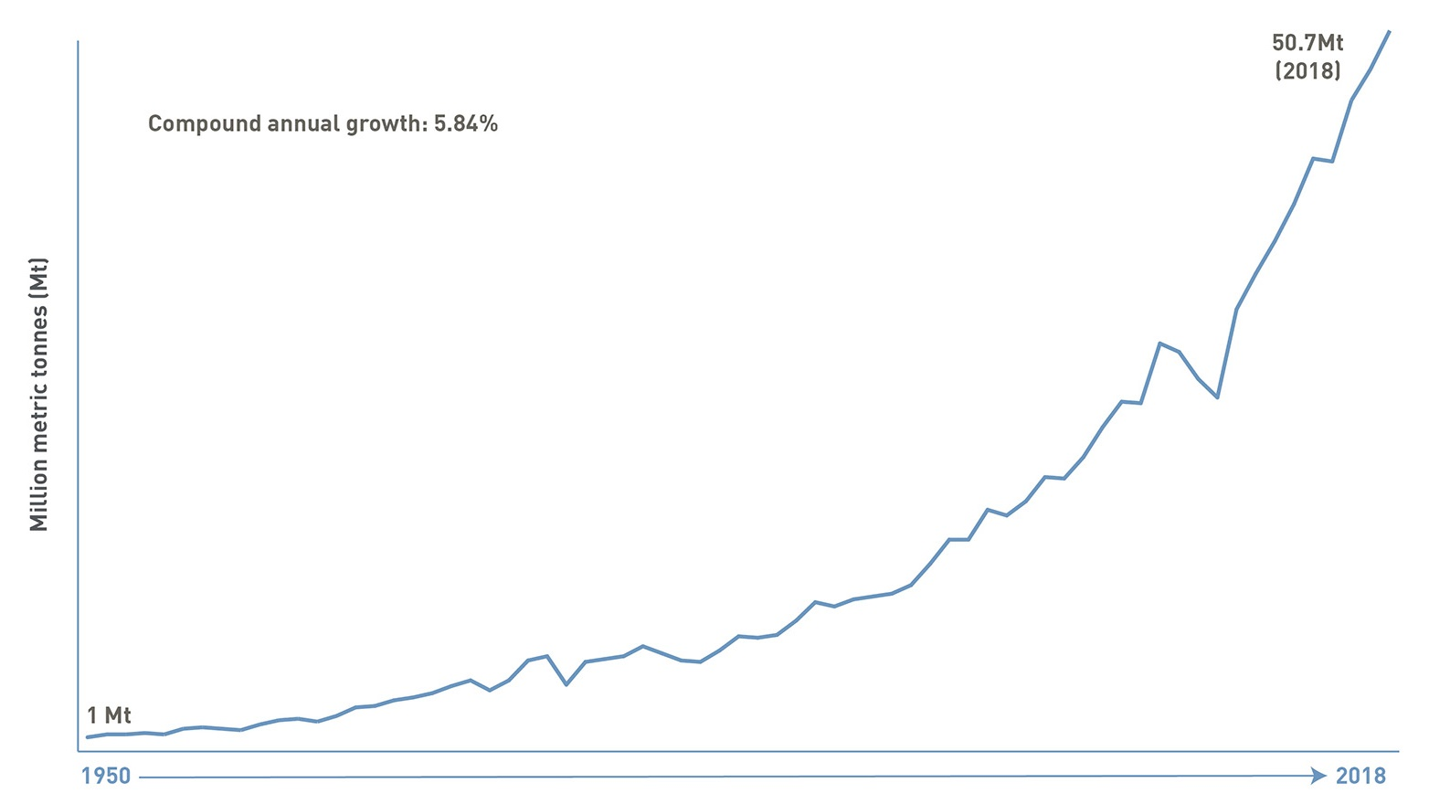
Compound annual growth of world Stainless Steel meltshop production²² (Millions of Metric tons)

Slide 12
Why Stainless steel?

Slide 13
Because of an outstanding set of properties
Corrosion resistance (see chapter 3 )
  In all environments: tropical to polar, sea or desert, polluted or not…
  Self-repairing, unlike coatings
Lasting forever with little or no maintenance
Wide range of mechanical properties allowed by several stainless families(Cr-Ni Austenitics – Cr-Mn Austenitics – Cr Ferritics – Duplex – Cr C Martensitics) and now built into the major building codes. Plus an excellent fire resistance (see Chapters 4 and 5)
Aesthetics: Large selection of surface finishes à colors available (see chapter 6). Plus resistance to damage in public areas
Easy fabrication/joining (see chapter 7)
Excellent sustainability (see chapter 9)
  allows a long service life with no or little maintenance,
  100% recyclable (and more than 85% recycled) at the end of life into stainless steel without loss of properties
Safe and Hygienic: Inert, no contamination, easy to clean & disinfect
Specific properties: magnetic/non magnetic, ….

Slide 14
What limits the use of stainless steels: the price
Stainless Steels are expensive: True? Or False?
Answer: Yes and No
Yes:
If the initial material cost is all what matters (usually because of limited funding…)
But then a bad choice may be very expensive:
Stainless steel usually represents a small part of the project
Untimely repairs and maintenance may add huge direct and indirect costs
No:
if
the Life Cycle Cost (the « real » cost) is taken into account, i.e. if maintenance, service life and recycling issues are factored in*
the design is optimized: thin sheets, profiled into complex shapes can result, in strong, stiff structures that use little material.
*The owner’s best interest is always to make choices based on LCC analysis

Slide 15
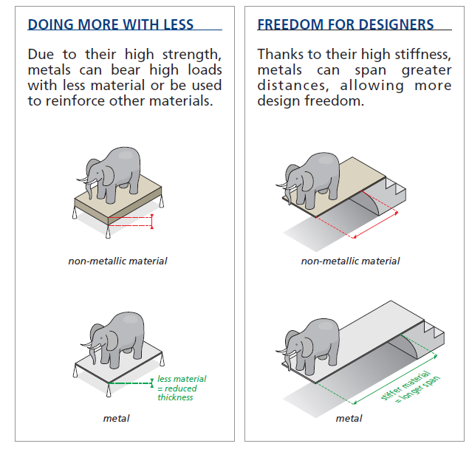
Stainless (and other metals) use less material¹⁶
Thin gauge 0,4mm and 0,6mm thick stainless steel sheets are commonly used.
Weight: 3,12Kg and 4,68Kg respectively per m² only!

Slide 16
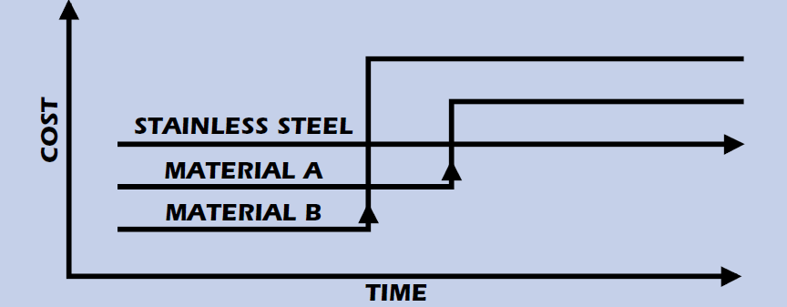
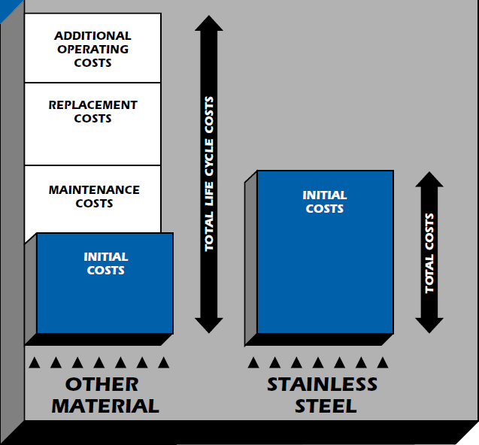
Why stainless steel is not expensive if the life cycle cost is taken into account
The cost of structures made of other materials substantially increases over time while the cost of stainless steel structures normally remains constant.
The Cost of corrosion exceeds 276 Billions $ in the USA alone ¹⁷
Notes:
www.ssina.com
Source: Specialty Steel Industry of North America, Stainless steel information center (www.ssina.com)

Slide 17

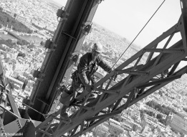
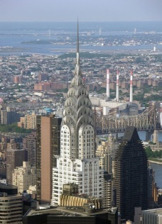

Life Cycle Cost Comparison of 2 old structures^{18,19}
Structures | Completed | Material | Height | Maintenance
Eiffel Tower – Paris * | 1889 | Wrought iron | 324m | Every 7 years. Every painting campaign lasts for about a year and a half (15 months). 50 to 60 tons of paint, 25 painters, 1500 brushes, 5000 sanding disks and 1500 sets of work clothes.
Chrysler Building (Roof and Entrance) – New York | 1930 (roof 1929) | Austenitic Stainless Steel (grade: 302) | 319m | Twice in 1951, 1961, 1995. The 1961 cleaning solution is unknown. A mild detergent, degreaser and abrasive was used in 1995.
* The Eiffel tower was built before stainless steel was invented…and it was supposed to be a temporary structure, but the public loved it !

Slide 18
Example:
Comparison of the maintenance of 2 very well known bridges^{20, 21}
Golden Gate Bridge in San Francisco
Stonecutter’s Bridge in Hong Kong
In the next 2 slides

Slide 19

The Golden Gate bridge (1937), San Francisco
<- Maintenance
“a rugged group of 13 ironworkers and 3 pusher ironworkers along with and 28 painters, 5 painter laborers, and a chief bridge painter battle wind, sea air and fog, often suspended high above the Gate, to repair corroding steel. Ironworkers replace corroding steel and rivets with high-strength steel bolts, make small fabrications for use on the Bridge, and assist painters with their rigging. Ironworkers also remove plates and bars to provide access for painters to the interiors of the columns and chords that make up the Bridge. Painters prepare all Bridge surfaces and repaint all corroded areas.” ²⁰

Slide 20
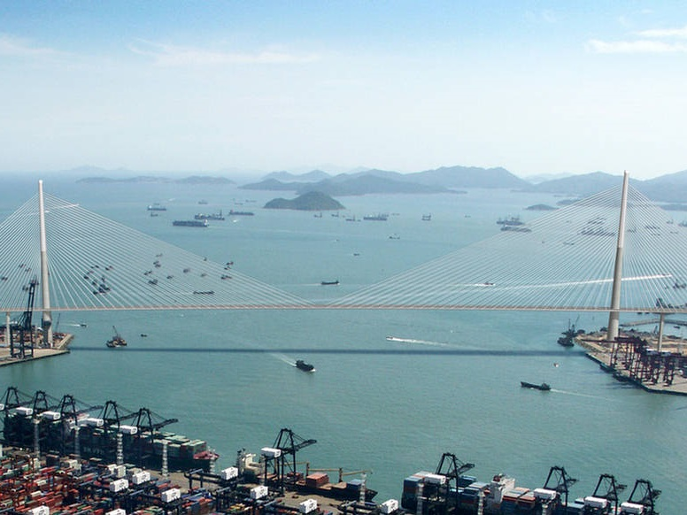
Stonecutter’s bridge (2009), Hong Kong
<- Maintenance
Project details : 1,596m-long dual 3-lane high-level cable-stayed bridge, with a clear span of 1,018m. Typhoon resistant.
Material : Stainless Steel EN1.4462 (Duplex) plate with 450MPa yield stress used for the towers above +175m to top (+295m) and for towers skin.
Why stainless rather than C-steel: designed for 120 years life in a hot and polluted seawater environment. Designed for no maintenance. ²¹
Notes:
Sources:
http://en.wikipedia.org/wiki/Stonecutters_Bridge
http://www.menainfra.com/article/Nickel-containing-materials-contribute-towards-a-sustainable-society/

Slide 21
Main references
https://worldstainless.org/
(a) http://www.hablakilns.com/the-brick-industry/the-brick-market/
(b) http://wiki.answers.com/Q/What_is_the_weight_of_a_red_clay_brick_in_Kilograms
CEM bureau https://cembureau.eu/cement-101/key-facts-figures/
(a) https://www.worldsteel.org/ (b) www.globalcastingmagazine.com
http://www.fao.org/faostat/en/#data/FO
https://www.plasticseurope.org/en/resources/market-data
(a) http://www.glassforeurope.com/en/industry/global-market-structure.php (b) https://www.statista.com/statistics/609964/flat-glass-market-key-info-globally-projection/
http://www.world-aluminium.org/statistics/primary-aluminium-production/
https://www.worldstainless.org/statistics/stainless-steel-meltshop-production/
http://www.withbotheyesopen.com/
http://www.ssina.com/overview/markets.html
http://www-mdp.eng.cam.ac.uk/web/library/enginfo/cueddatabooks/materials.pdf
http://www.nickelinstitute.org/~/Media/Files/TechnicalLiterature/CapabilitiesandLimitationsofArchitecturalMetalsandMetalsforCorrosionResistanceI_14057a_.pdf
http://www.aperam.com/
Wikipedia
https://european-aluminium.eu/media/1310/en-metals-for-buildings-essential-fully-recyclable.pdf

Slide 22
Main references (Cont’d)
http://www.corrosioncost.com
US Federal Highway administration reports FHWA-RD-01-156 and 157 www.corrosioncost.com
a) https://www.toureiffel.paris/en b) http://corrosion-doctors.org/Landmarks/Eiffel.htm
a) http://en.wikipedia.org/wiki/Chrysler_Building b) https://www.nickelinstitute.org/library/?opt_perpage=20&opt_layout=grid&searchTerm=11023&page=1
http://goldengatebridge.org/research/facts.php#IronworkersPainters
https://www.worldstainless.org/files/issf/non-image-files/PDF/Structural/Stonecutters_Bridge_Towers.pdf
https://www.worldstainless.org/Files/issf/non-image-files/PDF/ISSF_Stainless_Steel_in_Figures_2019_English_public_version.pdf

Slide 23
Thank you
Test your knowledge of stainless steel here:
https://www.surveymonkey.com/r/3BVK2X6

