Slide 1
Supporting presentation for lecturers of Architecture/Civil Engineering
Module 02A:
Applications - Architecture

Slide 2
Contents
  Facades
  Green walls
  Roofs
  Decoration
  Plumbing
  Escalators and lifts
  Airports
  Urban furniture
  Restoration
  Arenas
  Swimming pools

Slide 3
1. Facades

Slide 4
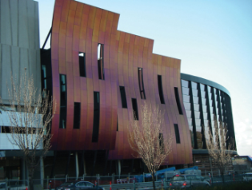
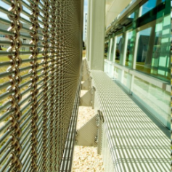
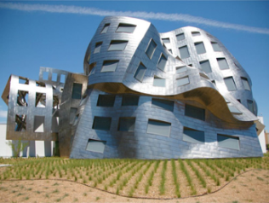
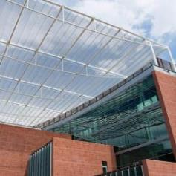
Clockwise, from top left:
Westfield Doncaster shopping center facade in Victoria, Australia ⁴
Sunbreaker Stainless mesh ion a school facade near Whashington, DC, USA. Reduces glare,saves energy offers good visibility⁶
Stainless mesh canopy over courtyard, Arizona, USA. Maximizes sun blockage while allowing air flow⁶
Lou Ruvo medical Research Center designed by Frank Gehry, Las Vegas, USA⁵

Slide 5
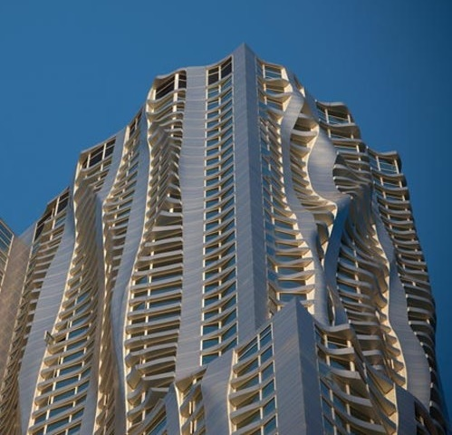
Stainless facade of 285m-high apartment building, New York, USA. Architect: Frank Gehry ⁷

Slide 6
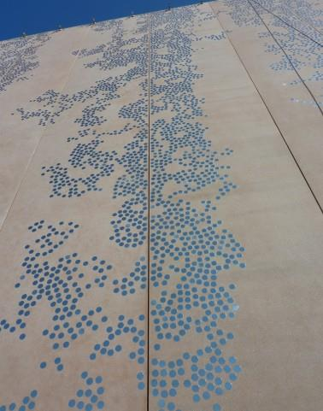
Reflective stainless steel inserts in a concrete wall for an archive building, Bure-Saudron (51), France⁸

Slide 7
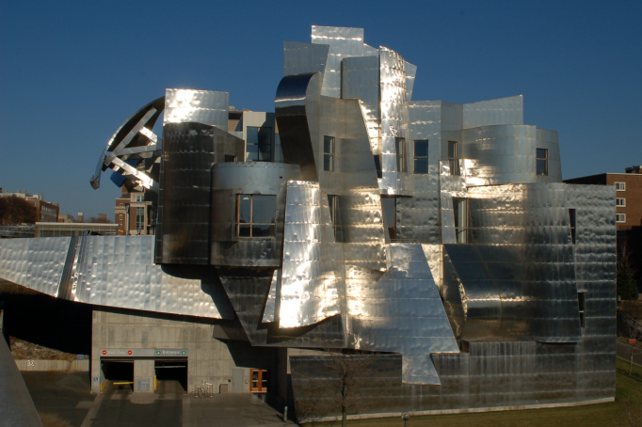
F. R. Weismann Art Museum, Minneapolis, USA (1993)
Architect: Frank Gehry⁹
Gehry: "I always have felt that architecture was about materials. Watching my artist friends work directly with materials – the right product is something that seems right and real and acceptable and not contrived."
For the Weisman, Gehry chose stainless steel… Its shiny, reflective, but extremely durable surface has given the building its unique identity.
Notes:
http://www.artsconnected.org/artsnetmn/environ/gehry.html

Slide 8
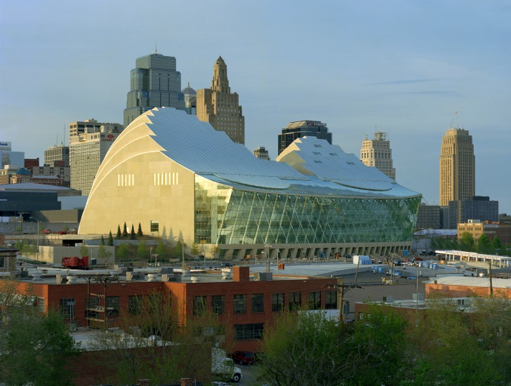
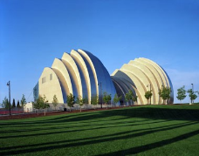
Kauffman Center of Performing Arts, Kansas City, ISA (2011)
Architect: Moshe Safdie; Engineering: Arup¹⁰
The north elevation of the building, which faces downtown Kansas City, features a series of arched walls sheathed in stainless steel that rise from the ground like a wave. From its crest a curved glass roof sweeps down towards the low-rise Crossroads neighborhood to the south and cascades into a 65-foot high by 330-foot wide glass wall, which provides the Kauffman Center's Brandmeyer Great Hall with panoramic views of Kansas City. This dramatic glass facade and roof are anchored by 27 high-tension steel cables, reminiscent of a stringed instrument.
Notes:
Architect: Moshe Safdie Structural Engineer: Arup USA, Inc.
http://www.arcspace.com/features/moshe-safdie-/kauffman-center-for-the-performing-arts/

Slide 9
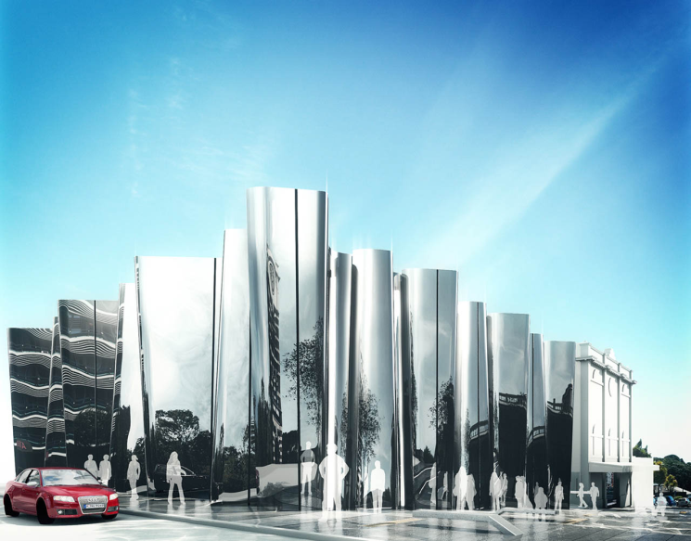
Len Lye Centre, New Plymouth, NZ
Architect: A. Patterson¹¹
14 m high facade made of 32 tons of highly polished grade 316 stainless steel
Notes:
http://www.pattersons.com/mobile/project/len-lye-centre
Fabricating the Len Lye Centre's 32-tonne stainless steel facade is a huge challenge for Taranaki company Rivet.
However, the owner of the New Plymouth business, Steve Scott, says he is loving every minute of it.
The $2 million project to construct the 14-metre-high facade of the New Plymouth centre, which will showcase the work of film maker and kinetic sculptor Len Lye, was a pleasant change from making sinks, hand rails and tanks, Scott said.
"The technical challenge is the best part of the job - the guys love a good challenge." In total, he said the project would equate to the equivalent of a year's work for six staff.
The company had to buy new laser- cutting machinery and create new tooling in-house in order to be able to fabricate the facade, which will be made up of about 510 panels of stainless steel.
The 3000 square metre Len Lye Centre, attached to the Govett-Brewster Art Gallery, was designed by architect Andrew Patterson and is being built by New Plymouth company Clelands Construction.
The total cost of the project, which has been 100 per cent externally funded with zero council borrowing or contribution from New Plymouth District ratepayers, is $11.5 million.
Scott said he spent about six months working with Patterson and Clelands Construction on a facade design they were all happy with and that Scott was confident could be engineered.
About 32 tonnes of the mirror sheet - grade 316 stainless steel - was ordered from a Japanese mill, which Scott said was the only place that could make that grade of steel to the size required.
It was then sent to Taiwan to be polished to a level 8, mirror-like finish. Again, Scott said Taiwan was the only place with the facilities to polish metal of that size to the finish required.
He said he did not know of any other buildings that were constructed of such a material. The tooling developed by Rivet enabled the company to create a curve in the steel panels that was exactly as the architect wanted.
The panels, each measuring 2.8 metres by 1.5m, would fit into each other like a jigsaw to create the Len Lye Centre's facade, which would run along Devon and Queen streets.
Scott said though joins would be visible, they would be as minimalistic as possible.
Rivet, which was established by Scott and his father 22 years ago, became involved with the project at the beginning of 2013 after the tender for construction was awarded to Clelands. Stainless steel was chosen by the architect for the facade because it was, in a sense, a local material.
Ad Feedback
"It's sort of like using the local stone and architects always like using local products," Patterson told the Taranaki Daily News in 2011.
"If you use local material, you engage local industry and expertise." He said Taranaki's stainless steel industry was one of the best in the world, because of the dairy industry.
Scott said he would not have taken on the project if he wasn't 100 per cent sure it could be done.
"I was confident we could do it. We often push the boundaries." By September the panels should start being installed, he said, and the job had to be completed by December. The Len Lye Centre is due to open next year.
Scott said before the panels could be installed, curved concrete walls being made by a Whanganui company using a mould also fabricated by Rivet needed to be erected.
In Rivet's Strandon workshop, sheet metal worker Ian Smith was busy welding away at the framing that would go behind the panels to hold them in place.
He had been working on the project since November, he said, adding with a grin that he was looking forward to seeing the end of it.
Scott also looked forward to seeing the finished product and he was proud to be part of the project.
"I think it will look pretty cool. And if the job's going to go ahead, we might as well be doing it."
- Taranaki Daily News

Slide 10
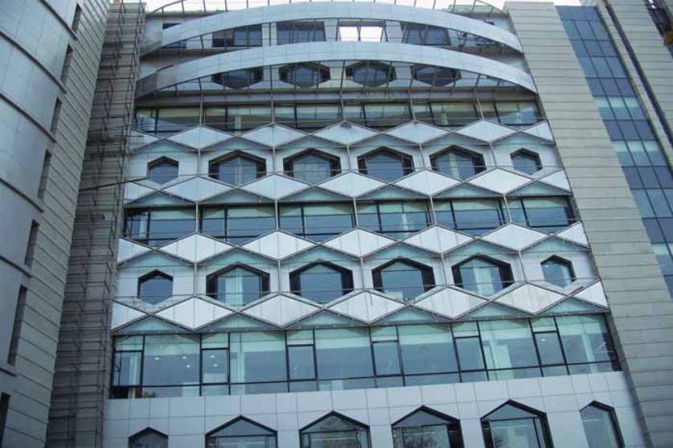
Delhi Metro Rail Corporation Headquarters, India
Architect: Raj Rewal & Associates¹²
Architect Raj Rewal & Associates designed stainless steel cladding for the building in New Delhi, involving stainless steel tubular truss with stainless steel panels interspersed with toughened glass panels.

Slide 11
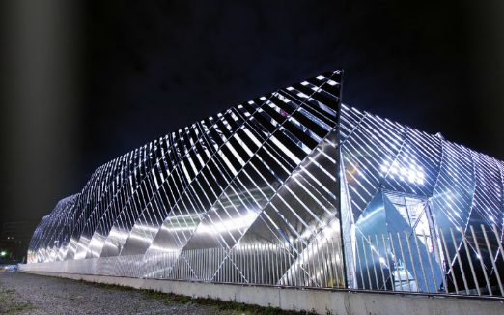
District heating facility, Torino,Italy
Architect: JP Buffi¹³
The heating facility has been clothed by curved screens.
The copper-coloured stainless strips are arranged to provide gaps for a glimpse through to the facility.
Notes:
http://issuu.com/hda_paris/docs/hda_2011_references_web_issu

Slide 12
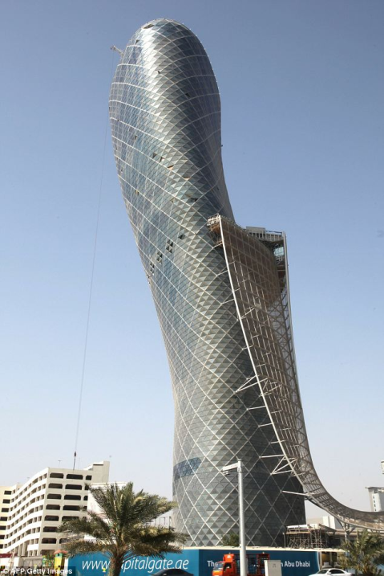
Capital gate Tower (2010), Abu Dhabi
RMJM, Architects¹⁴⁻¹⁶
The distinctive stainless steel ‘splash’ that descends from the 19th floor, is a design element and a shading device that eliminates over 30 percent of the sun’s heat before it reaches the Capital Gate building. The splash also twists around the building towards the south to shield the tower as much as possible from direct sunlight.
The ‘splash’ is made of 580 panels for a total of ~5000 m² of stainless steel mesh
Notes:
http://www.dailymail.co.uk/travel/article-1284591/Abu-Dhabi-Capital-Gate-skyscraper-leans-times-Tower-Pisa.html
http://www.e-architect.co.uk/dubai/capital-gate-abu-dhabi
http://www.gkd.de/en/gkd/news/news/d/the-worlds-most-inclined-building/

Slide 13
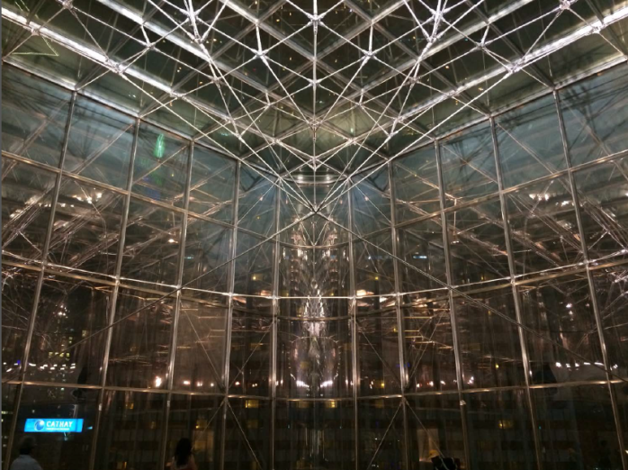
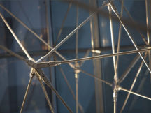
Glass facade¹⁷
A web of stainless steel tie-bars linked by nodes holds the glass facade, maximizing open light area, including corners
Notes:
http://hda-paris.com/

Slide 14
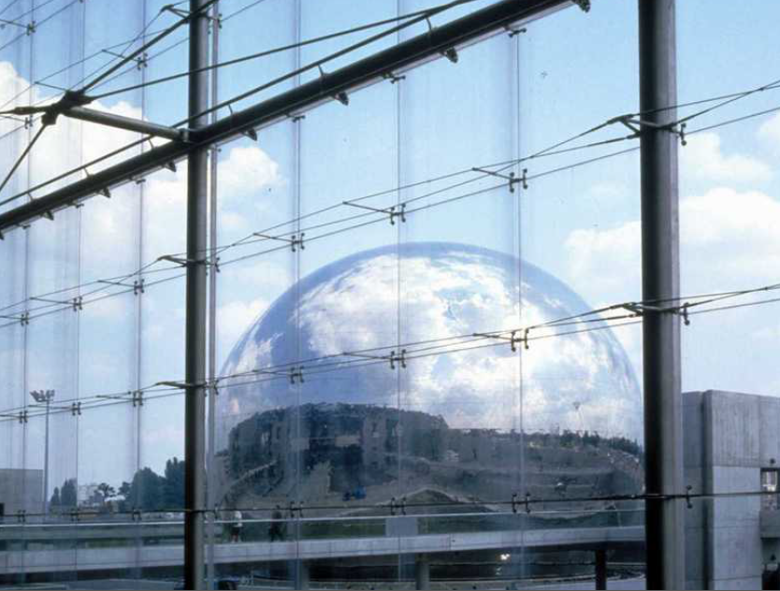
Glass facade, Paris ¹⁸
The glass facade is supported by a light, high strength stainless steel structure
The sphere in the background is the «Geode», a unique stainless steel clad 360° movie theater, part of the «Cité des Sciences et de l’industrie»
Notes:
http://hda-paris.com/
http://www.lageode.fr/la-geode/

Slide 15
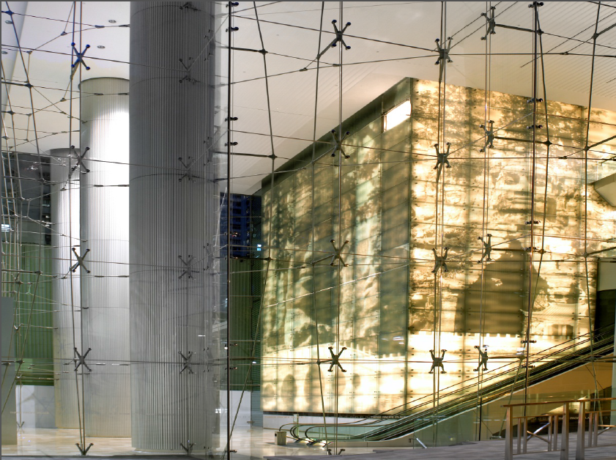
Glass facade, Paris¹⁹
Notes:
http://hda-paris.com/

Slide 16
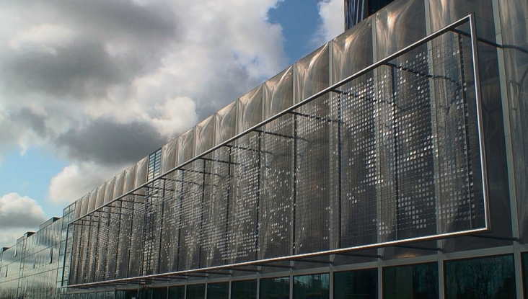
Office building mesh facade, Utrecht, Netherlands²⁰
Architects: Cepezed
This 3000 m² stainless steel mesh facade holds transparent plastic disks.
Wind causes the mesh to vibrate and the disks to move, resulting in ripples and light effects.
Notes:
http://5osa.tistory.com/archive/200906

Slide 17
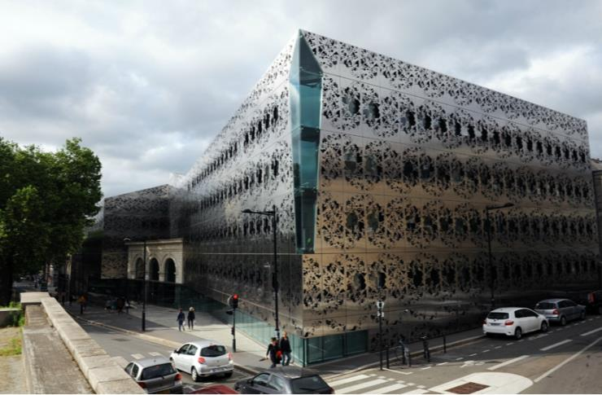
Energy saving building, Nantes, France ²¹
Architects: FORMA 6 & B. Dacher
Intricate laser cut shapes of the stainless steel facade give this building an outstanding look.

Slide 18
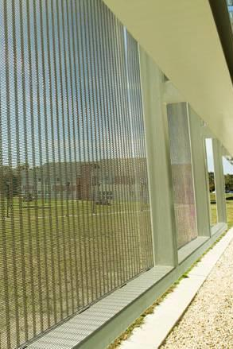
McGowan Academic center,
Washington, DC, USA
Sunshade mesh⁶
McGowan Academic Center is a classroom building community college.
The building design provided for an atrium area integrated with an exterior ventilated façade, in the center of the building that faced directly east in the morning hours.
The stainless sunshade reduces the daytime glare and the amount of air conditioning required to cool the space in the summer months. Typical metal sunshade products could not be used for this application as visibility was crucial. They simply didn't offer enough open area.
Notes:
: www.cambridgearchitectural.com

Slide 19
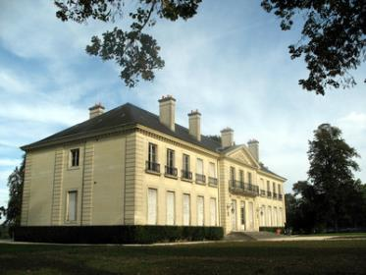
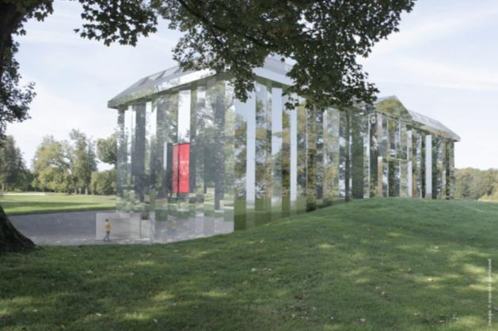
Rehab of Château de Rentilly, France²²⁻²³
Left: Before
Below: After
A contemporary art building in the park of a château.
The facade has been clad with mirror-finish stainless steel plates
Xavier Veilhan, architect:
«… the building was a shadow of what it was….
I wanted walls that would reflect the surrounding park… »
Notes:
http://www.marneetgondoire.fr/les-albums-photos/album-photos-490/le-chateau-de-rentilly-renaissance-en-2013-230.html?cHash=d2d475c49fe75ee015495efb35c04460
http://www.marneetgondoire.fr/parc-culturel-de-rentilly/le-chateau-rehabilite-un-nouvel-espace-d-art-contemporain-859.html

Slide 20
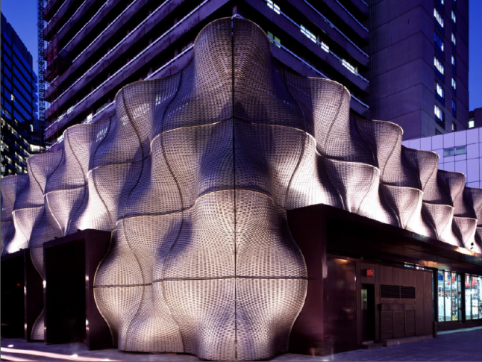
St Guy Hospital , London²⁴
Architect: T. Heartherwick
The Boiler Suit, a unique façade designed to encase the boiler house which powers Guy’s Hospital. It is made up of 108 undulating tiles of woven stainless steel braid and is illuminated at night to provide a distinctive welcoming beacon for staff and visitors arriving at hospital in the dark.
Notes:
http://www.dezeen.com/2007/08/20/boiler-suit-by-thomas-heatherwick/

Slide 21
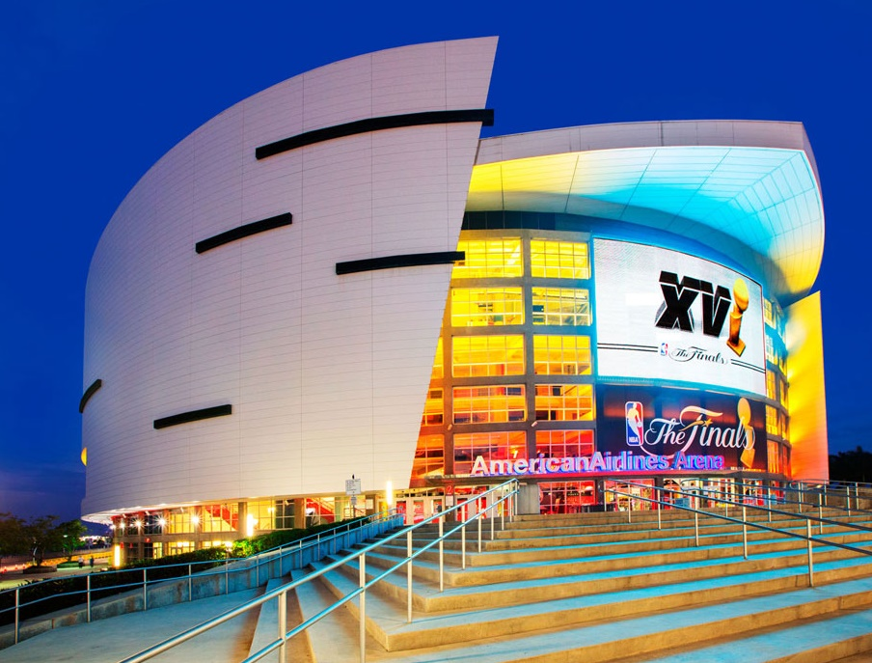
American Airlines Arena, Miami, USA
Made from 3,400 square feet of a high-grade architectural woven stainless steel mesh fabric with interwoven LED profiles, Miami’s Mediamesh® screen, provides visitors to the Arena with unobstructed viewing from the interior and visually engaging digital media content on the exterior. Standing three-stories tall (42 feet high by 80 feet wide), Miami’s Mediamesh façade is four times the size of an average billboard. The arena host more than 1.3 million guests per year for concerts, family and sporting events.

Slide 22
Facades References (1/2):
UPDATED 2019!
https://www.worldstainless.org/Files/issf/non-image-files/PDF/Euro_Inox/Facades_EN.pdf
https://www.worldstainless.org/Files/issf/non-image-files/PDF/Euro_Inox/Innovative_facades_EN.pdf
http://www.archiexpo.com/architecture-design-manufacturer/stainless-steel-facade-cladding-2964.html more examples here!
http://www.steelcolor.com.au/westfield-doncaster/
http://wikimapia.org/7695594/Cleveland-Clinic-Lou-Ruvo-Center-for-Brain-Health#/photo/3116187
http://cambridgearchitectural.com/
https://newyorkbygehry.com/
http://archinect.com/firms/project/39353/edf-archives-center/9174600
http://greatbuildings.com/buildings/Weisman_Art_Museum.html
http://www.arcspace.com/features/moshe-safdie-/kauffman-center-for-the-performing-arts/
http://pattersons.com/civic/len-lye-contemporary-art-museum/
http://www.stainlessindia.org/UploadPdf/SI_Mar08.pdf
http://www.archilovers.com/projects/30432/centrale-termica-teleriscaldamento-iride-energia.html
http://www.skyscrapercenter.com/building/capital-gate-tower/3172

Slide 23
Facades References (2/2):
UPDATED 2019!
http://www.dailymail.co.uk/travel/article-1284591/Abu-Dhabi-Capital-Gate-skyscraper-leans-times-Tower-Pisa.html
http://www.e-architect.co.uk/dubai/capital-gate-abu-dhabi
http://hda-paris.com/
https://www.parisinfo.com/musee-monument-paris/71198/La-Geode
http://issuu.com/hda_paris/docs/hda_2011_references_web_issu
http://5osa.tistory.com/entry/Cepezed-and-Ned-Kahn-Studios-Vertical-Canal-fa%C3%A7ade-Utrecht-Netherlands
http://www.reseaux-artistes.fr/dossiers/beatrice-dacher/architecture-sully-2006-2010
http://www.marneetgondoire.fr/les-albums-photos/album-photos-490/le-chateau-de-rentilly-renaissance-en-2013-230.html?cHash=d2d475c49fe75ee015495efb35c04460
http://www.marneetgondoire.fr/le-parc/les-espaces-1705.html
http://www.dezeen.com/2007/08/20/boiler-suit-by-thomas-heatherwick
http://www.gkdmediamesh.com/blog/the_role_of_metallic_mesh_in_transforming_stadium_architecture.html

Slide 24
2. Green Walls

Slide 25
About Green Walls
Green Facades are an emerging architectural element, providing an enormous amount of benefits to a building through occupant amenity, thermal control and improving air quality.
Using stainless steel cables, rods and mesh to train climbing plants up a building facade provides an alternative to the traditional planted green wall.
Retro-fitting a green facade to existing structures is easily achieved.

Slide 26
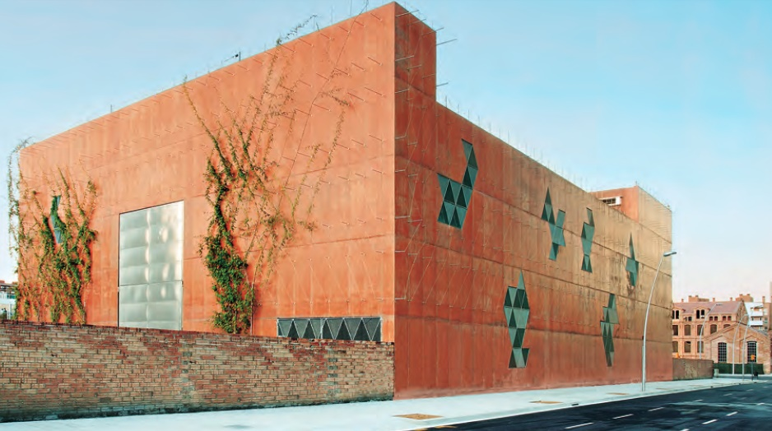
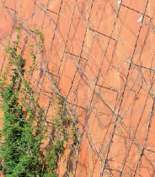
Green facade¹
Electric transformer building, Barcelona. Stainless fasteners and cables support the plants.

Slide 27
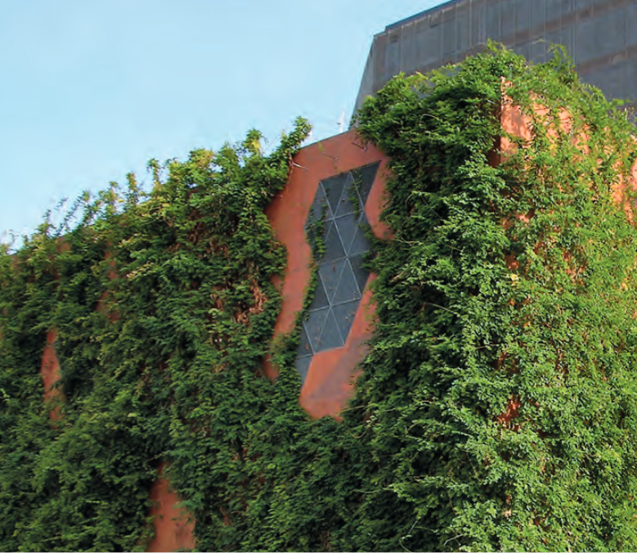
Green facade ²
A few years later. Improved aesthetics.

Slide 28
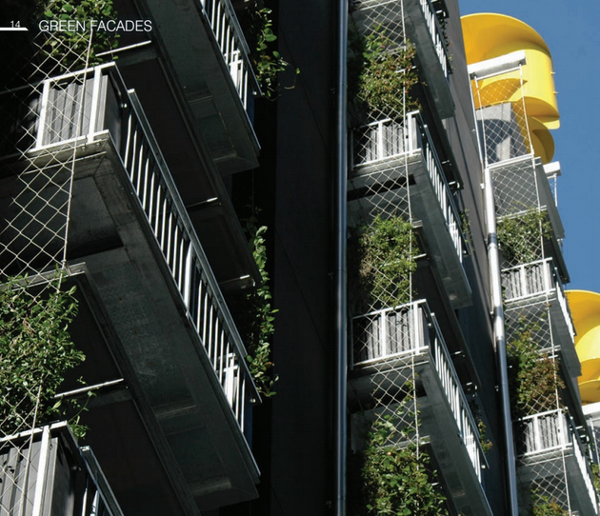
Green walls for apartment buildings²
(affordable everywhere!)
Advantages :
Improved insulation
Noise damping
Cooler micro-climate
Enhanced biodiversity
Better air quality pollutants filtration)
Aesthetics
Psychological well-being
Positive social and economic fallout
Stainless cables and anchors

Slide 29
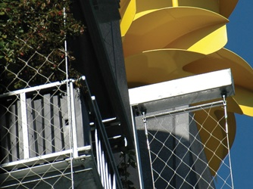
Green walls for apartment buildings²
The benefits of re-introducing Mother Nature to an increasingly unnatural environment are so apparent that the Australian Government has established the Green Building Council of Australia (GBA) to advocate sustainable property development.
Notes:
Source: www.assda.asn.au

Slide 30
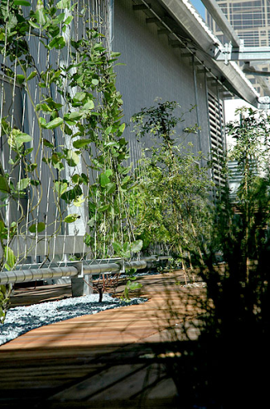
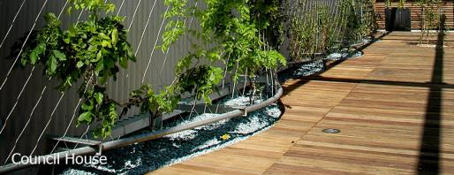
Vertical Landscaping
Melbourne City Council Chambers: The stainless steel trellising systems and components provide essential climbing structure for the plant life, and transform the hard heat retaining surfaces into vibrant vertical gardens.
Notes:
Source: www.ronstantensilearch.com

Slide 31
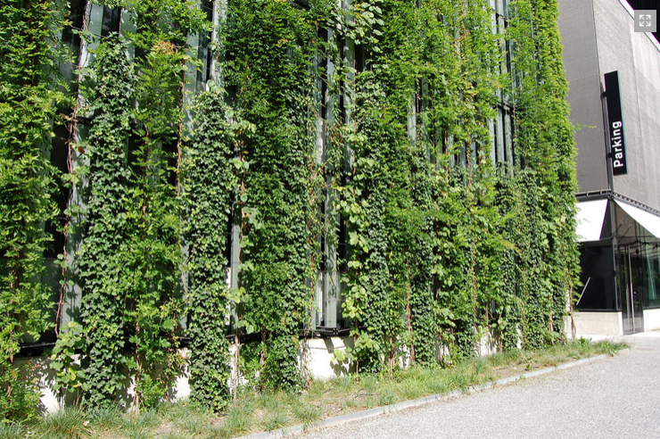
Green wall³
Notes:
http://www.jakob.co.uk/information/image-galleries/greenwall-systems-gallery/large-scale-greenwall-systems.html

Slide 32
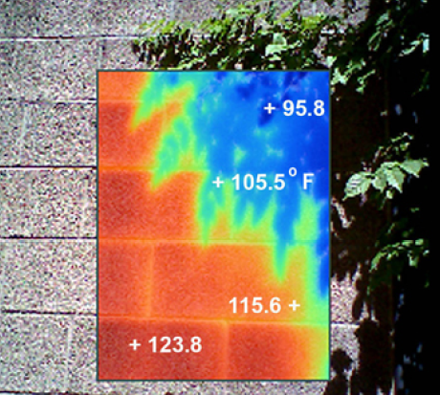
Infrared photography demonstrating temperatures of the building surface, Tampa, AZ. °F, from ref. 4.

Slide 33
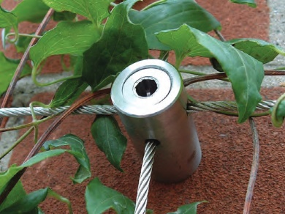
Anchors and cables
Stainless steel systems are easy to install
Notes:
https://www.s3i.co.uk/image/s3i/stainless-steel-wire-trellis-system.pdf
http://www.telegraph.co.uk/gardening/gardeningadvice/8352361/Social-climbers-How-to-cover-a-house-in-plants.html

Slide 34
Green Walls References
https://www.worldstainless.org/Files/issf/non-image-files/PDF/Euro_Inox/VertGardens_EN.pdf
http://www.ronstantensilearch.com/melbourne-city-council-chambers-northern-green-facade/
http://www.jakob.co.uk/information/image-galleries/greenwall-systems-gallery/large-scale-greenwall-systems.html
http://drum.lib.umd.edu/bitstream/1903/11291/1/Price_umd_0117N_11876.pdf
http://www.architectureartdesigns.com/30-incredible-green-walls/

Slide 35
3. Roofs

Slide 36


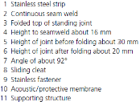
Usual characteristics of stainless steel roofs¹⁻⁴
 | Inclined (>3%) | Flat
Material | Ferritics 1.4509 1.4510 | Ausenitics 1.4301 1.4401
Joining | Mechanical | Welding (for water tightness)
Surface Finish | Matte or terne coating (Sn)* | Matte or 2B (when there is a top layer)
Thickness | 0.5mm; 0.4 mm for rainwater goods Allows a lightweight structure
Life expectancy | Will last the life of the building
Other |  | Suitable for green roofs In renovation can be placed directly on the bitumen roof
* In some areas Cu or Zn are restricted as being eco-toxic and leaching into the rainwater

Slide 37
A new concern, metal runoff in rainwater⁵
Mostly in northern Europe ... Stems from demands on water quality, availability and re-use
No significant runoff from stainless steel

Slide 38
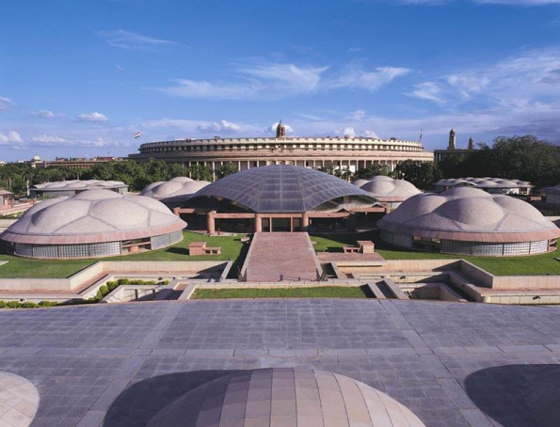
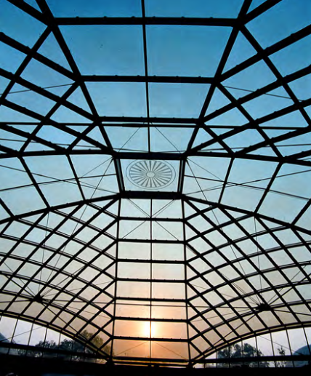
The Delhi Parliament Library⁶⁻⁷
Architect: Raj Rewal Associates
1. Left: Overview, with the Parliament in the back. | 2. Right: View of central focal dome
The library, ~ 55,000 m², had its height restricted to avoid obstructing the Parliament House. The central focal dome comprises a lattice of stainless steel tubular members and cables converging at key tension cast nodes. The second dome containing stainless steel tubes , known as the VIP dome, has a diameter of 16 m and a height of 2.5 m.

Slide 39
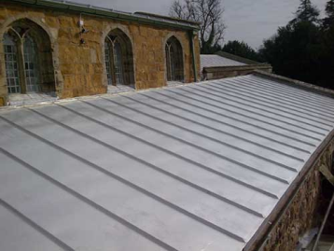
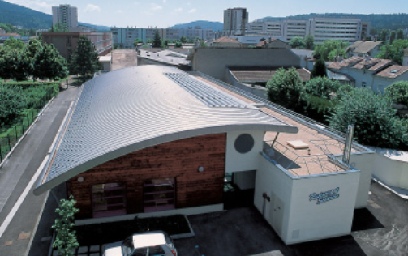
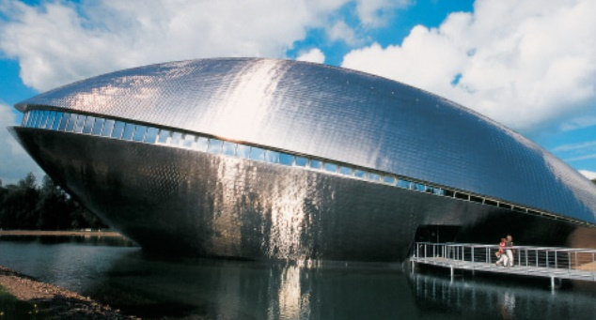
Clockwise, from top left:¹
1. Stainless church roof, Leicester, UK
2. School restaurant, Oyonnax, France
3. Universum Science centre, Bremen, Germany

Slide 40
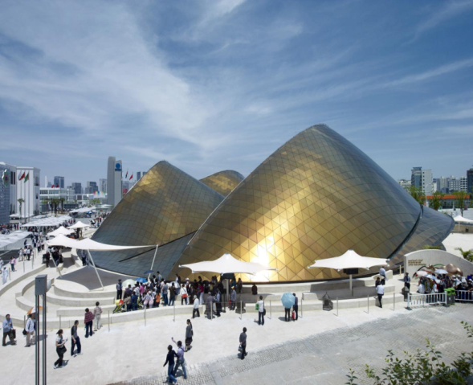
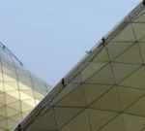
UAE Pavilion at the Shanghaï Expo⁸
Architects: Foster & Partners
The dune-like structure is made of triangulated lattice covered with flat stainless steel panels. It has been designed to be demounted.
Notes:
http://www.fosterandpartners.com/projects/uae-pavilion-shanghai-expo-2010/

Slide 41
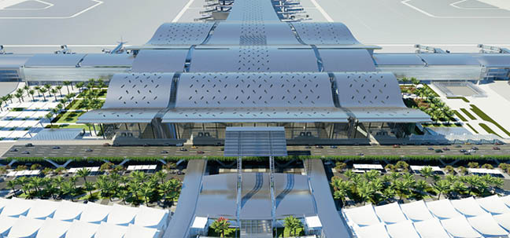
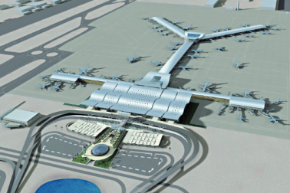
New Doha airport, Qatar⁹⁻¹⁰
Architects: HOK
The undulating roof is said to be the largest stainless steel roof in the world (195000m²).
It features a non-directional, low gloss, uniformly textured stainless steel finish.
A lean duplex grade was selected.
No maintenance is required.
Notes:
https://www.atimetals.com/markets/Documents/Doha.pdf
http://www.metalresources.net/index.php?option=com_content&view=article&id=152:worlds-largest-stainless-steel-roof-to-feature-invarimatter-finish-from-cmr&catid=1:latest-news-a-press&Itemid=192

Slide 42
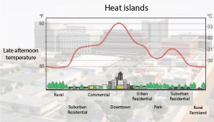
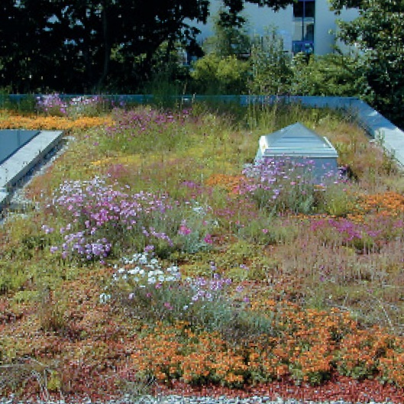
Green Roofs^{1-4, 11-12}
Advantages
Mitigate heat islands
Reduce dust
Promote biodiversity
Provide insulation
Reduce flood risks
Reduce noise
Absorb CO₂
Aesthetics
Psychological well-being
Positive social and economic fallout
Limits
Requires a sturdy structure
Needs a proper know-how
May need watering in summer
Some maintenance is required
More expensive

Slide 43
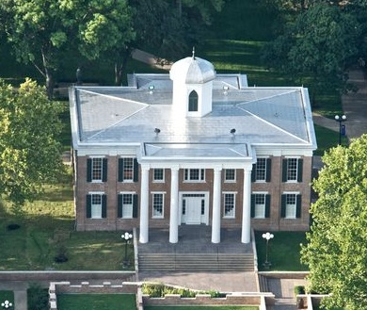
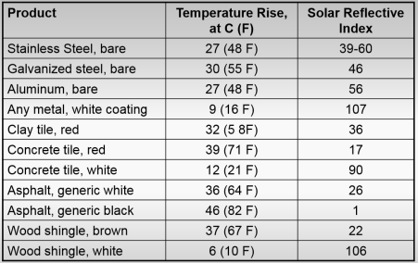
High Reflectance Roof
Austin Hall Sam Houston State University Huntsville, Tx, USA (1851)
Low glare*, high reflectance stainless steel roof ^{11,13}
High Reflectance (Albedo) roofs mitigate heat islands in cities.
Solar Reflectance is now included in LEED (Leadership in Energy and Environmental Design)
SRI of Proprietary finishes > 100
* The surface must provide a diffuse light reflection (i.e. avoid mirror-like reflection). Highly polished surfaces are not suitable.

Slide 44
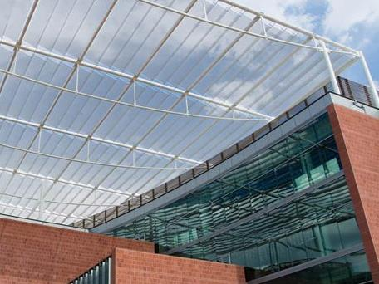
Sunbreakers¹⁵
University of Arizona Medical Research Building & Thomas Keating Bioresearch Building
Canopy-type shading
Mesh with 43% open area: maximises sun blockage while allowing air to pass between the panels.
Notes:
www.cambridgearchitectural.com/

Slide 45
Roofs References
https://www.worldstainless.org/Files/issf/non-image-files/PDF/Euro_Inox/Roofing_EN.pdf
http://ssina.com/download_a_file/roofing.pdf
https://youtu.be/ZQledV2QFRY
http://www.bssa.org.uk/cms/File/The%20Growing%20Market%20for%20Stainless%20Steel%20Roofing.pdf
O. Wallinder and C. Leygraf ASTM Special Technical Publication N°1421, « Outdoor Atmospheric Corrosion » pp 185-199
https://www.worldstainless.org/Files/issf/non-image-files/PDF/Structural/Parliament_Library_Building_Domes.pdf
http://www.architectureweek.com/2003/1022/design_1-3.html
http://www.fosterandpartners.com/projects/uae-pavilion-shanghai-expo-2010/
http://www.hok.com/design/service/engineering/hamad-international-airport/
https://www.rigidized.com/exteriorscmt.php
a) http://www.stainlessindia.org/UploadPdf/Dec%202011%20wshop%20Part-I.pdf
b) http://www.wbdg.org/resources/cool-metal-roofing
http://www.constructalia.com/repository/transfer/en/01921518ENLACE_PDF.pdf
http://www.rigidized.com/saveenergy.php
http://www.stainlessindia.org/UploadPdf/Dec%202011%20wshop%20Part-I.pdf
www.cambridgearchitectural.com/

Slide 46
4. Decoration

Slide 47
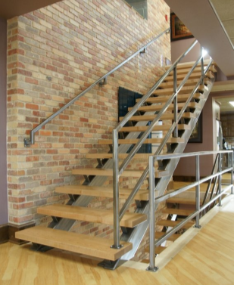



Clockwise, from top left:
Wood and stainless stairs (unspecified location)
Curved wire mesh ceiling (Louisiana State University)
Restaurant in Finland with transparent room divider
Door handle

Slide 48

Banque de France, Paris, France⁴
Architects: Moati -Rivière
Mirror finish EN 1.4301 (AISI 304)
Notes:
http://www.uginox.com/fr/node/180

Slide 49

Metro station L5 El Carmel, Barcelona, Spain⁵
Woven stainless steel mesh wall panels

Slide 50


Mosteiro da Batalha, Portugal⁶
Stainless steel mesh curtain
Open Area 36 %
Weight 0.25 kg/m²
Rod diameter 0.05 mm.
Wire pitch 0.13 x 0.13 mm.
Notes:
http://www.theinoxincolor.com/en-proyectos-malla-id80_mosteiro-da-batalha.html

Slide 51


Home curtain/safety banister⁷
Stainless steel
Open area 44 %
Weight 5,2 kg/m²
Cable diameter 4 x 0.75 mm.
Rod diameter 1.5 mm.
Cables pitch 26.4 mm.
Wire pitch 3 mm.
Notes:
http://www.theinoxincolor.com/en-malla-modelos-id15_weber-440-architectural-mesh.html

Slide 52

Museum of contemporary art & planning exhibition, Shenzhen, China (under construction)
Architect: CoopHimmelblau⁸

Slide 53
Decoration References
http://www.seoic.com/cable_railing.htm
http://cambridgearchitectural.com/projects/louisiana-state-university-lsu-student-union-theater
http://www.twentinox.com/projects/item/36/Transparent+stainless+steel+curtain+panels
http://www.uginox.com/fr/node/180
http://www.cedinox.es
http://www.archilovers.com/projects/58425/mosteiro-da-batalha.html
http://www.theinoxincolor.com/portfolio_category/decorative-mesh-projects/
http://www.coop-himmelblau.at/architecture/projects/museum-of-contemporary-art-planning-exhibition

Slide 54
5. Stainless Steel Plumbing

Slide 55




Clockwise, from top left:
Sanitary piping
Press-fitted tubes
Kitchen faucet
Shower head with light

Slide 56

Stainless piping system

Slide 57
Stainless Steel Plumbing References
https://www.worldstainless.org/Files/issf/non-image-files/PDF/Euro_Inox/PressFittingSystems_EN.pdf
http://www.nickelinstitute.org/~/media/Files/TechnicalLiterature/StainlessSteelPlumbing-color-EN_11019_.ashx
https://nickelinstitute.org/library/?opt_perpage=20&opt_layout=grid&searchTerm=pipes%20for%20buildings&page=1
http://www.bssa.org.uk/cms/File/BSSA%20PLUMBING%20P.1-4.pdf
https://www.grohe.de/de_de/badezimmer.html

Slide 58
6. Escalators and elevators

Slide 59



Clockwise, from top left:
Elevator (unspecified location)
Escalator (Prague Metro )
Moving sidewalk (Brussels Metro)

Slide 60

Mesh-clad elevator³
Notes:
http://cambridgearchitectural.com/projects/ft-lauderdale-hollywood-international-airport-rental-car-center

Slide 61

Kraaiennest metro station entrance, Amsterdam, NL⁴
Notes:
http://www.metalocus.es/content/en/blog/kraaiennest-metro-station-completed-amsterdam-maccreanor-lavington

Slide 62
References:
https://www.forms-surfaces.com/elevator-ceilings
http://commons.wikimedia.org/wiki/File:Metro_bruxelles_laufband.jpg
http://cambridgearchitectural.com/projects/ft-lauderdale-hollywood-international-airport-rental-car-center
http://www.cabworks.com/

Slide 63
7. Airports

Slide 64



Clockwise, from top left: stainless equipment at Montreal Airport, Canada
Boarding counter, Balustrade and Garbage bin
Drinking fountain
Bar counter and footrest

Slide 65



Clockwise, from top left:
Baggage delivery belt, Manila Airport, Philippines
Moving sidewalk, Montreal Airport, Canada
Security net in Copenhagen Airport, Denmark

Slide 66
Airports References
Stainless steels are used everywhere, as the requirements are materials are expected to be used by the public 365 days a year while retaining an excellent aesthetic appearance:
roofs,
urban furniture,
counters,
drinking fountains,
partitions,
ventilation equipment
handrails
elevators, escalators, moving sidewalks
baggage delivery carousels
pushcarts
fasteners
etc…

Slide 67
8. Urban furniture

Slide 68




Clockwise, from top left:
Fence near school in Budang, Korea. Grades: STS439 / STS304 Finish: 2B / HL / polishing
Handail in Gijòn, Spain. Grande: 316L Finish: Polished
Handrail, India
Lower Manhattan's South Ferry Subway Terminal “See it split, see it change” by by Doug and Mike Starn

Slide 69




Clockwise, from top left:
Bench in Paulinia (SP), Brazil. Grade: 304 STS304 Satin Finish
Butterfly bench in San Luis Potosi, Mexico
Bench with woven mesh, France
Lamp post, Seoul, Korea Grades: STS439 / STS304 / STS304N1 Finish: 2B / BA / Polishing

Slide 70




Clockwise, from top left:
Bus Stop, Istanbul, Turkey. Grades: AISI 304 and AISI 316 Finish: 2B / BA / Brushed / Scotch Brite
Bicycle rack, Albenga, Italy. Grade: EN 1.4301 (AISI 304)
Sculpture, « Invisible City » , Wellington, New Zealand
Joana Vasconcelos’s sculpture entitled « Marylin » and made of stainless pots

Slide 71







Slide 72
Urban Furniture References
https://www.worldstainless.org/applications/architecture-building-and-construction-applications/street-furniture/
http://norcor.free.fr/piazza_superbe_inox.jpg
http://listraveltips.com/wellington-street-art-stainless-steel-braille-sculpture/

Slide 73
9. Restoration

Slide 74


Left: Stainless steel entrance pavilion to the the crypt of the St Martin-in- the-Field Church, London
Right: Stainless and Glass Pyramide du Louvre, Paris

Slide 75




Opera theatre in Verona, Italy
The great Roman monument, dates back to the first half of the 1st Century AD and has been known as the most important open air opera theatre. Recent restoration work involved the construction of new covering for the central pit, where the orchestra sits, the underground room and the underground sewage tunnels. The new covering slab is supported by a system of roof struts and post tension tie rods. The post tension system used, comprising stainless steel bars, guarantees structural safety, quality and durability.
Notes:
Pictures: courtesy of Centro Inox, Italy

Slide 76


Roman Theater, Frejus, France
Restoration of the open air roman theater with teck and perforated 3 mm thick EN 1.4571 stainless steel sheet

Slide 77
Restoration References
https://www.worldstainless.org/Files/issf/non-image-files/PDF/Euro_Inox/New_meets_Old_EN.pdf

Slide 78
10. Arenas

Slide 79




Clockwise, from top left: ¹⁻³
1. Handrail in VIP entrance staircase, Wembley, UK; 2. Turnstile; 3. Lockers; 4. Stainless canopy and handrail on Bourke St pedestrian bridge to Melbourne’s Colonial stadium, Australia

Slide 80

Yamuna Stadium, Delhi, India ⁴
Architects: Peddle Thorb
On the occasion of the Commonwealth Games 2010, a multifunctional stadium was created in New Delhi. With its shining façade made of stainless steel mesh, the stadium symbolises sport as a means for modern and sustainable human interaction. The stainless steel cladding with an open area of 53 percent shields spectators from the fierce subtropical climate and provides effective sun protection.

Slide 81
Castelão Stadium, Fortaleza, Brazil^{5,6}
Architect: Vigliecca & Associados
The façade was entirely made of stainless steel expanded sheets. In addition to the external frame, stainless steel was used on railings, handrails at VIP areas, lavatories and locks of the stadium. “We have made an option for the durability stainless steel provides, which is essential to areas like the façade that required a corrosion-resistant material, and for its noble appearance, required in the hospitality sector”, says architect Ronald Fiedler, responsible for the Project.

Slide 82

Allianz Park Palmeiras Stadium, Sao Paulo, Brazil⁷
Architect: Edo Rocha Arquitetura
This is one of the most beautiful arenas in the world. Stainless Steel is intensively used in its façade. Stainless Steel is intensively used in its façade. The sheets of stainless steel have holes in them to facilitate the circulation of air.

Slide 83

Media Facade, Lille stadium, France⁸
Architects: Valode Pistre and Ferret
Stainless steel mesh media facade.
The mesh supports a high power, versatile LED system which permits individually programmable lighting effects, ranging from simple graphics to video content.
Notes:
http://www.editorialespazio.com/en/proyectos/detalle/94

Slide 84
Arenas References
http://www.cmf.co.uk/products/products.asp?id=92&product_id=4
http://www.assda.asn.au/blog/223-stainless-welcome-for-sports-fans
http://www.controlledaccess.com/
https://gkd-india.com/metalfabrics/yamuna-sports-stadium
http://www.vigliecca.com.br/en/projects/castelao-arena#gallery;%20
http://www.copa2014.gov.br/en/noticia/see-details-castelaos-architecture-project
http://edorocha.com.br/portfolio/allianz-parque/
https://www.osram.com/ls/projects/grand-stade-lille/index.jsp

Slide 85
11. Swimming Pools

Slide 86



Clockwise, from top left:
Olympic-size, stainless steel-lined swimming pool, Vichy, France
Custom stainless roof spa
Stainless steel handrail

Slide 87

Stainless Waterslide
Made from a single streamlined curve shape, the foot of the curve constitutes the steps that take the user to the top of the slide. The slide itself then loosens and turns in on itself.. To create a contrast, the designers used a mirror-polished finish on the interior while the exterior is brushed
"Polished stainless steel doesn't get too hot to touch, even in sunny climates," the UK-based designers explained. "In fact, it actually reflects sunlight and thermal energy as it doesn't oxidise like other metals."

Slide 88
Swimming Pools References
http://www.imoa.info/molybdenum-uses/molybdenum-grade-stainless-steels/architecture/french-pool-liner-article.php
http://www.constructalia.com/repository/transfer/fr/02163065ENLACE_PDF.pdf
http://www.awt-eisleben.de/en/swimming-pools-136.html

Slide 89
Thank you
Test your knowledge of stainless steel here:
https://www.surveymonkey.com/r/3BVK2X6

