Slide 1
Supporting presentation for lecturers of Architecture/Civil Engineering
Chapter 01
Art

Slide 2
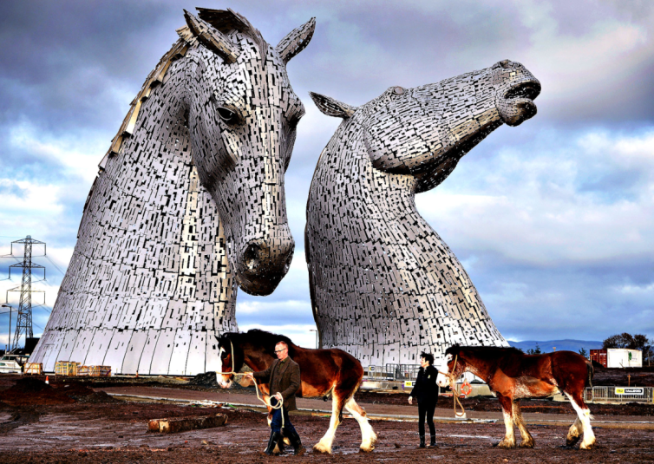
Andy Scott: The Kelpies ^{1, 2}
Location:
Falkirk, Scotland
Material:
Structural Steel Cladded with type 316L (S31603) Stainless Steel
Dimensions:
30 metres high
Weight:
300 tonnes each
Year created:
2013
Andy Scott: "The original concept of mythical water horses was a valid starting point for the artistic development of the structures. I took that concept and moved with it towards a more equine and contemporary response, shifting from any mythological references towards a socio-historical monument intended to celebrate the horse’s role in industry and agriculture as well as the obvious association with the canals as tow horses.”

Slide 3
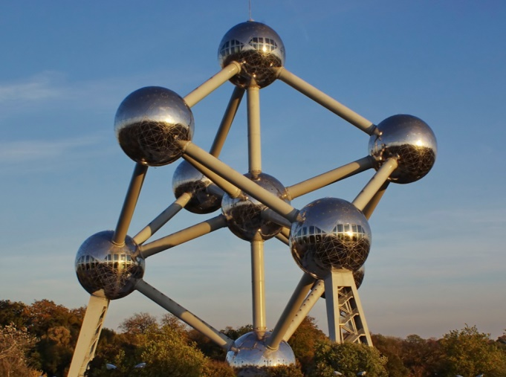
Design: A. Waterkeyn Architects: A. and J. Polak: Atomium ^{3, 4}
Location:
Brussels, Belgium
Material:
Polished 1.4404 (316L) stainless steel
Dimensions:
102 meters high with each of the nine spheres having a diameter of 18m
Weight:
2400 tons
Year created:
1958
The Atomium was constructed for the 1958 Brussels World Fair. Its nine spheres are connected so that the whole forms the shape of a unit cell of an iron crystal magnified 165 billion times. It was renovated between 2004 and 2006. The renovations included replacing the faded aluminium sheets on the spheres with stainless steel. CNN named it Europe's most bizarre building! It is one of the major attractions of Brussels .

Slide 4
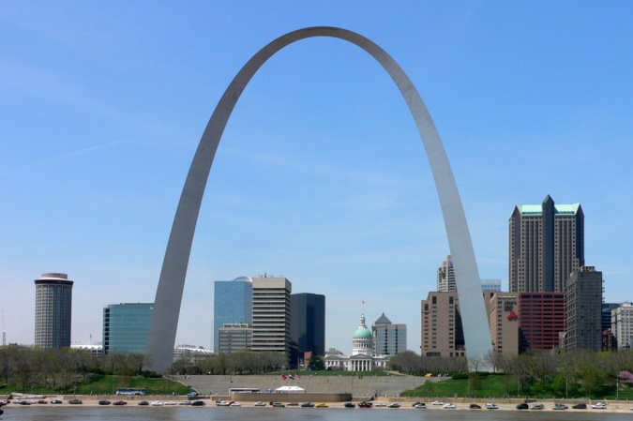
Designer: E. Saarinen Engineer: H. Bandel: Gateway Arch ^{5, 6}
Location:
St. Louis, MO, USA
Material:
AISI 304 Stainless Steel Cladding
Dimensions:
192m tall
Weight:
4164 tonnes
Year created:
1965
Intended to be “A suitable and permanent public memorial to the men who made possible the western territorial expansion of the United States….”, the gateway Arch in St Louis, MO, USA, is 192m tall, the world’s tallest arch, and has become the symbol of St Louis. The arch weighs 4164T, of which 803T of AISI 304 stainless steel cladding.

Slide 5
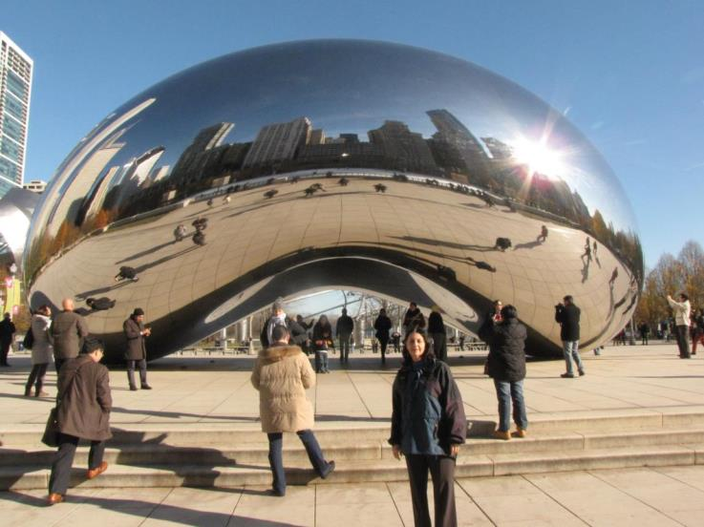
Sir Anish Kapoor: Cloud Gate ^{7, 8}
Location:
Chicago, USA
Material:
Highly polished 316 stainless steel plates
Dimensions:
10 by 20 by 13 m
Weight:
110 tonnes
Year created:
2004
Cloud Gate is British artist Anish Kapoor's first public outdoor work installed in the United States. The 110-ton elliptical sculpture is forged of a seamless series of highly polished stainless steel plates, which reflect Chicago’s famous skyline and the clouds above. A 12-foot-high arch provides a "gate" to the concave chamber beneath the sculpture, inviting visitors to touch its mirror-like surface and see their image reflected back from a variety of perspectives. Inspired by liquid mercury, the sculpture is among the largest of its kind in the world.

Slide 6
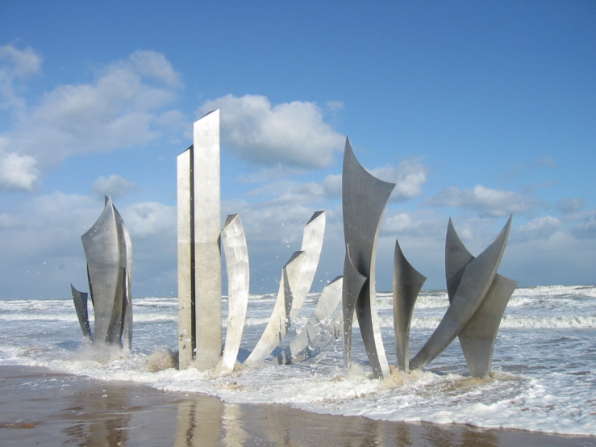
Anilore Banon: Les Braves ⁹ ⁻ ¹¹
Location:
Normandy, France
Material:
2205 and 316L stainless steel
Dimensions:
9m high
Weight:
Year created:
2004
This memorial stands on the beach known as Omaha Beach in the village St. Laurent-sur-Mer in Normandy, France and commemorates the soldiers that fell on the beaches of Normandy on D-Day, June 6, 1944. The memorial was dedicated on June 5 2004, for the 60th anniversary of the landing.

Slide 7
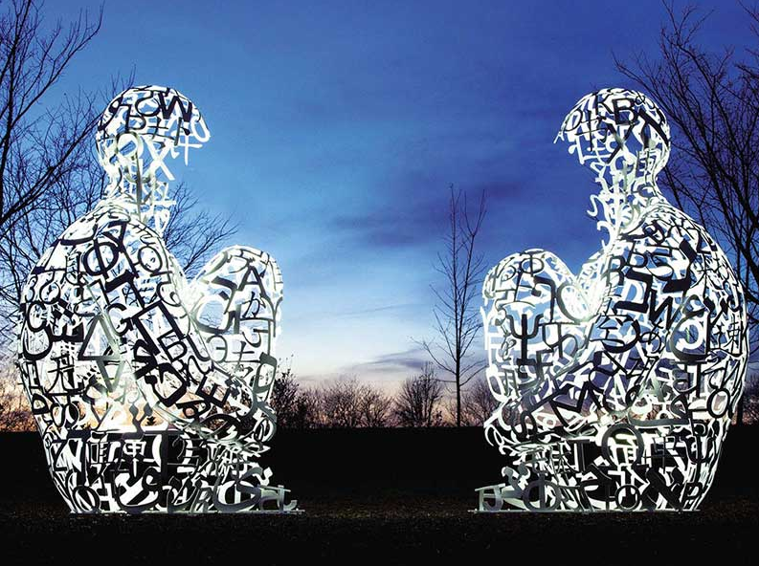
Jaume Plensa: Mirror I and II ^{12, 13}
Location:
Toledo Museum of Art, Toledo, OH, USA
Material:
Painted stainless steel
Dimensions:
377 x 235 x 245 cm
each
Weight:
Year created:
2010
The principal concept in this piece is that of dialogue. The two figures face one another as if in perpetual, silent conversation. The title, Mirror, is the act that the figures perform for one another — standing as reflections of the other’s thoughts and dreams. There is room enough between the two figures for the viewer to stand and “enter” the conversation. The figures are modeled in letters from eight alphabets – Arabic, Chinese, Greek, Hindi, Hebrew, Japanese, Latin and Russian. The artist considers this dialogue and interaction as central to learning, and more importantly to understanding, between people and cultures.

Slide 8
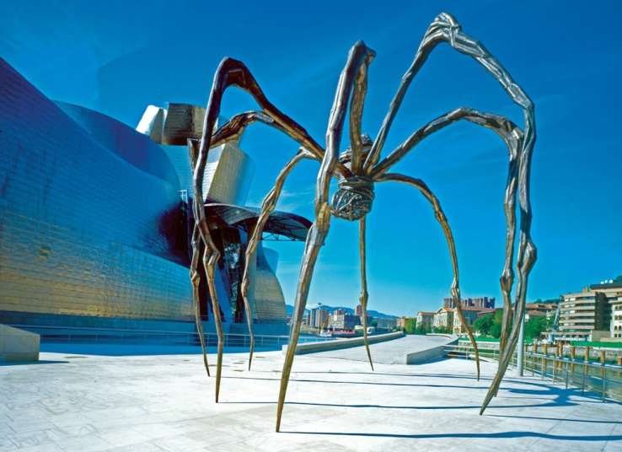
Louise Bourgeois: Maman ¹⁴
Location:
Guggenheim Museo, Bilbao, Spain
Material:
Bronze, marble, and stainless steel
Dimensions:
9mx10mx12m
Weight:
Year created:
1999
The title Maman enhances dynamic contradictions at the heart of the sculpture. Why the spider? “Because my best friend was my mother and she was deliberate, clever, patient, soothing, reasonable, dainty, subtle, indispensable, neat, and as useful as a spider. She could also defend herself, and me, by refusing to answer ‘stupid’, inquisitive, embarrassing, personal questions”

Slide 9
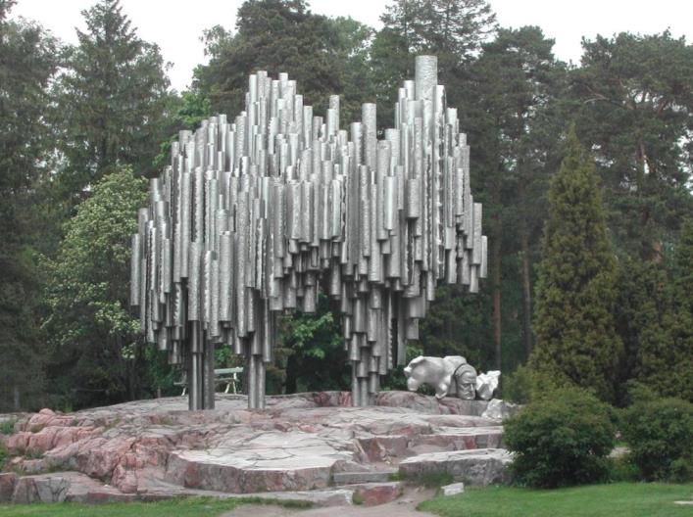
Eila Hiltunen: Sibelius Monument (1967) ¹⁵
Location:
Helsinki, Finland
Material:
600 Stainless Steel Tubes
Dimensions:
8.5 m high, 10.5m in length, and 6.5m in depth
Weight:
24 tonnes
Year created:
1967
The Sibelius Monument in Helsinki, Finland, is dedicated to the Finnish composer Jean Sibelius. Weighing around 24 tonnes, the sculpture is made up of more than 600 stainless steel tubes, welded together in a wave-like formation which resembles the shape of organ pipes.

Slide 10
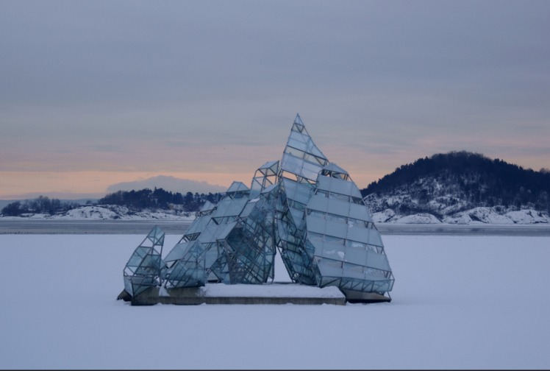
Monica Bonvicini: Hun Ligger (She Lies) ¹⁶
Location:
Oslo, Norway
Material:
stainless steel and glass panels
Dimensions:
12 by 17 by 16 m
Weight:
Year created:
2010
It is a permanent installation, floating on the water in the fjord on a concrete platform next to the Oslo Opera House, 12m above the water surface. The sculpture turns on its axis in line with the tide and wind, offering changing experiences through reflections from the water and its transparent surfaces.

Slide 11
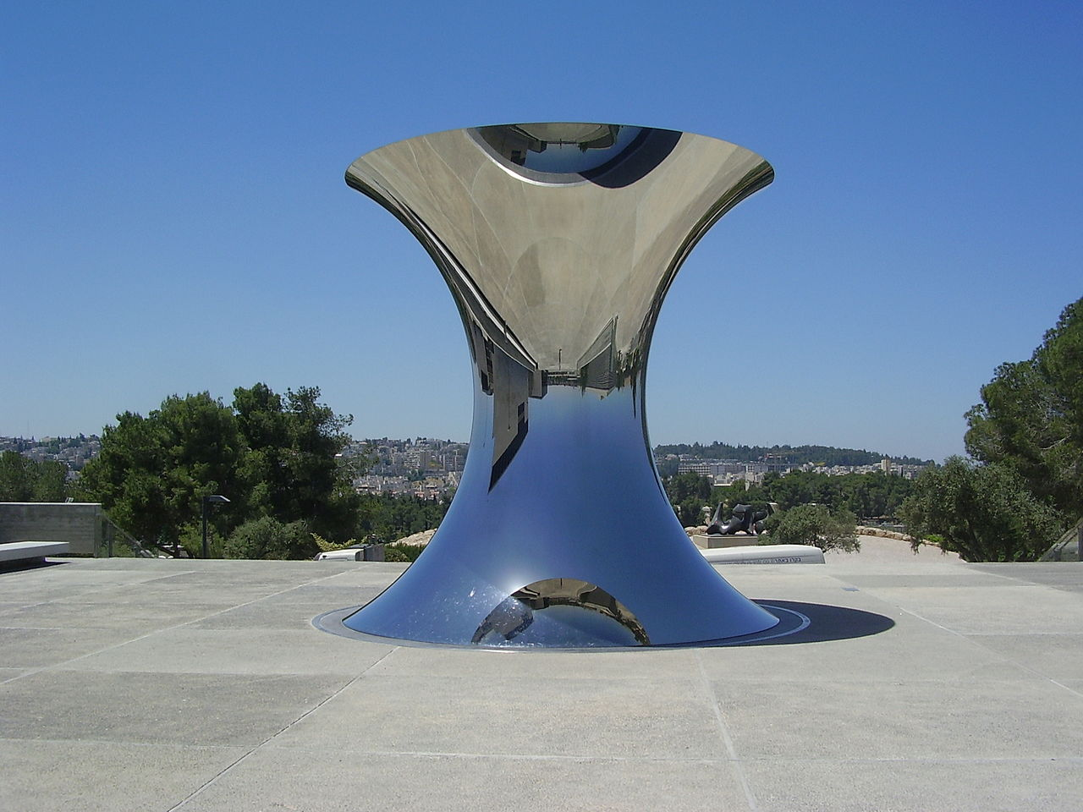
Sir Anish Kapoor: Turning the world upside down ¹⁷
Location:
Jerusalem
Material:
Polished Stainless Steel
Dimensions:
5m tall and 5m in diameter
Weight:
Year created:
2010
The stainless steel piece is 5 m tall and 5 m in diameter and flips the whole city of Jerusalem into the sky, signifying the spiritual importance of Jerusalem as a heavenly city.

Slide 12
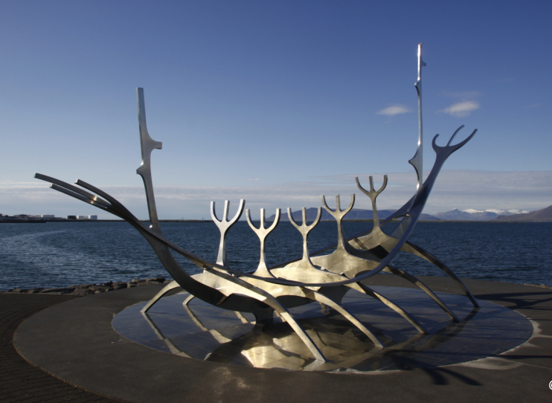
Jon Gunnar Arnason: Sun Voyager ¹⁸
Location:
Reykjavík, Iceland
Material:
Stainless Steel
Dimensions:
9 m x 18 m x 7 m
Weight:
Year created:
1990
“Sun Voyager is a dreamboat, an ode to the sun. Intrinsically, it contains within itself the promise of undiscovered territory, a dream of hope, progress and freedom”. The sculpture is located by Sæbraut, by the sea in the centre of Reykjavík, Iceland.

Slide 13
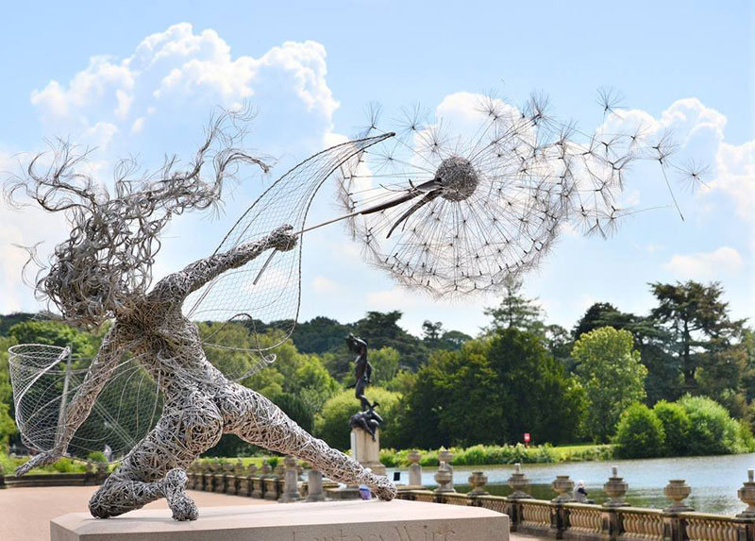
Robin Wight: Fantasywire ¹⁹
Location:
Trentham Gardens, UK
Material:
Stainless Steel Wire
Dimensions:
Weight:
Year created:
UK sculptor Robin Wight creates dramatic scenes of wind-blown fairies clutching dandelions, clinging to trees, and seemingly suspended in midair, all with densely wrapped forms of stainless steel wire. The artist currently has several pieces on view at the Trentham Gardens.
http://www.fantasywire.co.uk/

Slide 14
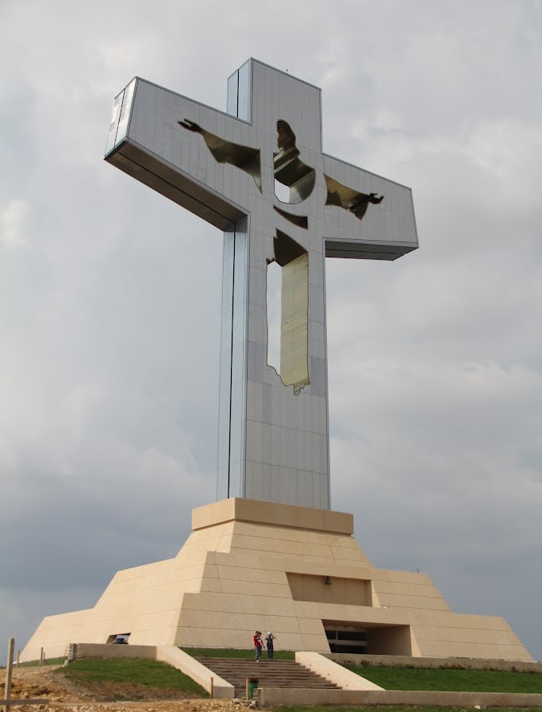
Architect Jaime Latapi Lopez: Cristo de Chiapas ²⁰
Location:
Tuxtla Gutierrez, Mexico
Material:
Coated Stainless Steel
Dimensions:
48m (62m with the base)
Weight:
2000 tonnes
Year created:
2007
The "Cristo de Chiapas" is an impressive cross, which is coated with gold-colored stainless steel accentuating the figure of Christ and shines in the reflection of the lights of the sun.

Slide 15
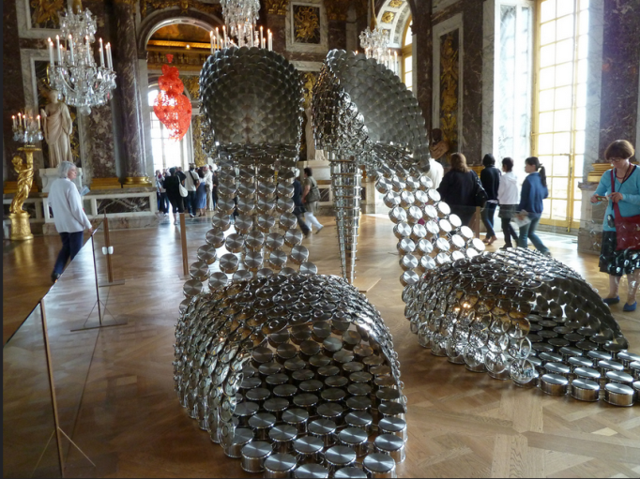
Joana Vasconcelos: Marylin (2009) ²¹
Location:
Versailles, France
Material:
Stainless Steel
Dimensions:
3m x 1.5m x 4m
Weight:
Year created:
2009
Marilyn takes the form of an elegant pair of high-heeled sandals, whose enlarged scale results from the use of saucepans and their respective lids. The unlikely yet assertive association between the saucepans and high-heeled sandals, two paradigmatic symbols of Woman's private and public dimensions, proposes a revision of the Feminine in the light of the practices of the contemporary world. The recourse to saucepans, sign to which one would associate the traditional domestic sphere of Woman, in order to reproduce an enormous high-heeled sandal, symbol of beauty and elegance demanded by social conventions, contradicts the impossibility of the dichotomic relation of the Feminine in the domestic and social spheres. The represented object thus emerges as panegyric of the feminine duality, insinuating the full realization of individuality through the subversion of the social norm.

Slide 16
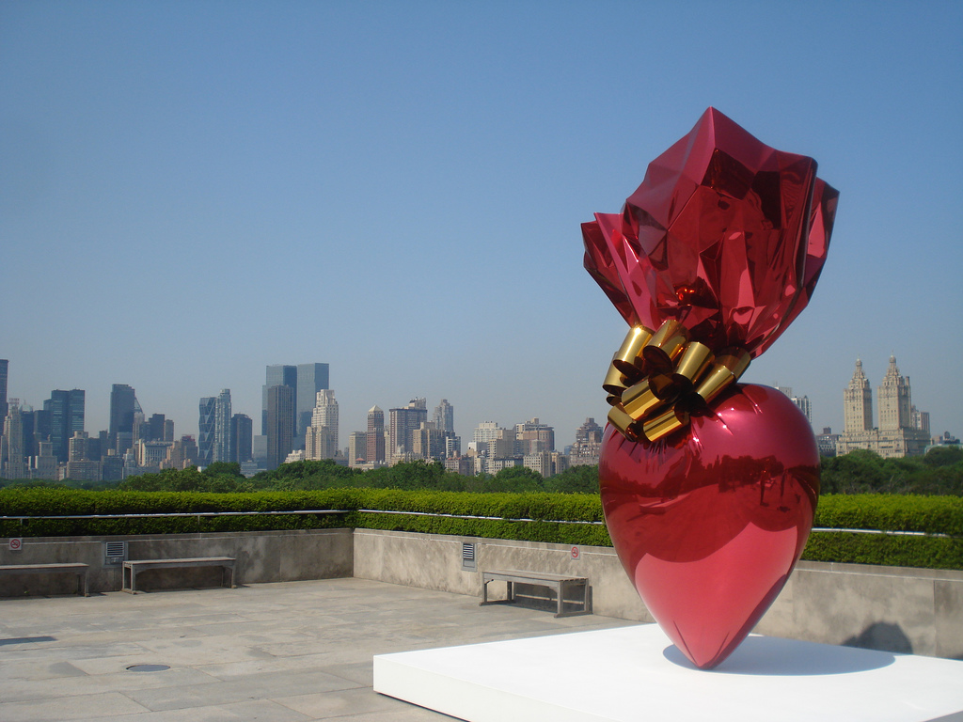
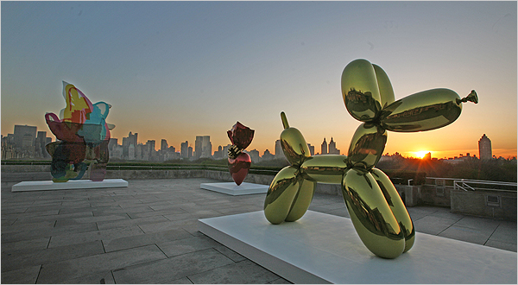
Jeff Koons: Sacred Heart Red/Gold …²²
Location:
New York, USA
Material:
High chromium stainless steel with transparent color coating
Dimensions:
357 x 218 x 121 cm
Weight:
Year created:
1 of 5 unique versions 1994–2007
“….acidly comments on the commercial debasement of emotional and religious experience.”
(NY Times)

Slide 17
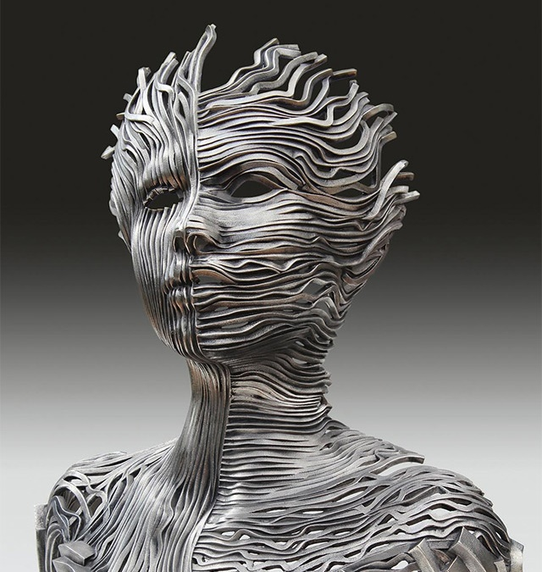
Gil Bruvel: Dichotomy ²³
Location:
Material:
316L Stainless Steel
Dimensions:
71 cm x 41 cm x 41 cm
Weight:
Year created:
Inspired by the complexities of living fully in all worlds at once, Dichotomy meditates on and celebrates the dual nature of existence. Composed of “ribbons of energy” that seek to capture the process of engaging all levels of being in order to be fully human, the sculpture reflects the natural strength and quiet majesty inherent in integrating the various levels of existence. As a result, the figure inhabits a serene meditative space, fully embracing a dichotomy of existences: anima and animus, male and female, conscious mind and unconscious mind, waking and dreaming.

Slide 18
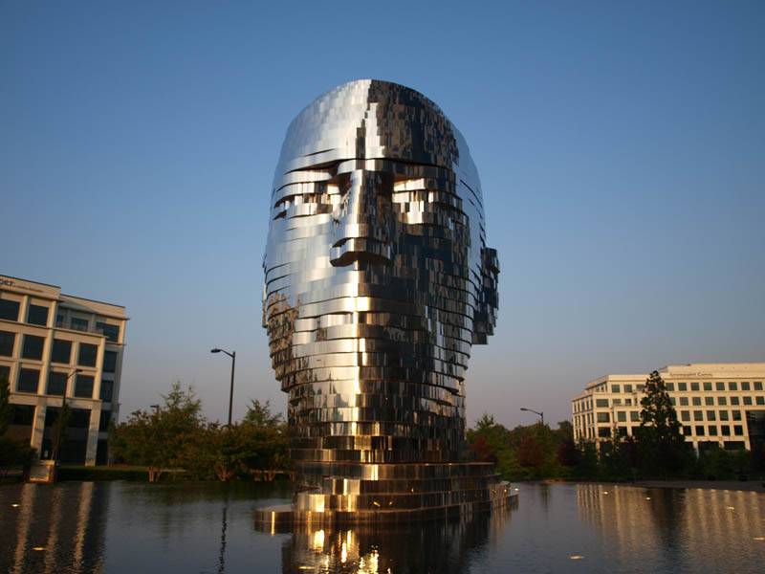
David Černý: Metamorphosis ²⁴
Location: Charlotte, NC, USA
Material: stainless steel
Dimensions: Height 8m
Weight: Uses 14T of stainless steel
Year created: 2011
The structure is comprised of seven separate layers that rotate intermittently, dissecting the sculptures features. Custom-written programs control motors embedded within the structure to orchestrate choreographed sequences. Every motor has a feedback switch so the computer knows where each piece is at any given moment, allowing for random motion within the sequences. This movement is controlled via the Internet by David himself and represents a continuation of his work that incorporates mechanical engineering and computers as an integral part of the design. Live streaming video of the sculpture in motion can be viewed online at www.metalmorphosis.tv
Notes:
http://twistedsifter.com/2011/10/metalmorphosis-sculpture-david-cerny/

Slide 19
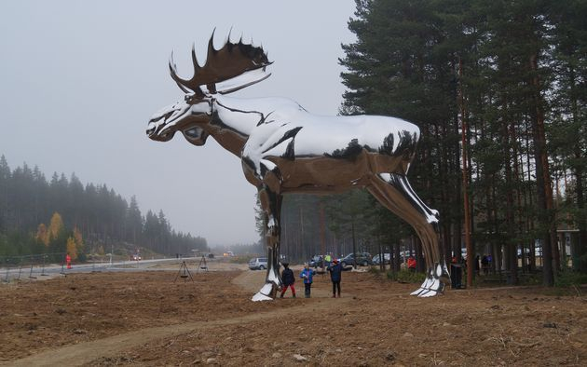
Linda Bakke: The Big Elk ²⁵
Location:
Midway between Oslo and Trondheim, Norway
Material:
Polished 316 Stainless Steel
Dimensions:
H: 10.3m
L: 11,5m
Weight:
Year created: 2015
The Big Elk, which was designed by Norwegian artist Linda Bakke, stands on the Bjøråa picnic area in Stor-Elvdal municipality midway between Oslo and Trondheim in Norway. This landmark, apart from its being inherently beautiful, is to attract drivers attention and increase road safety as it invites drivers to stop and stretch their legs and rest, thereby combatting fatigue.
The Big Elk has also focused attention on the animals and has become a regional symbol.
Sparebanken Hedmark art fund provided NOK 2 million (207,000 euros) to produce the sculpture.
http://lindabakke.webs.com/sculptureskulptur.htm

Slide 20
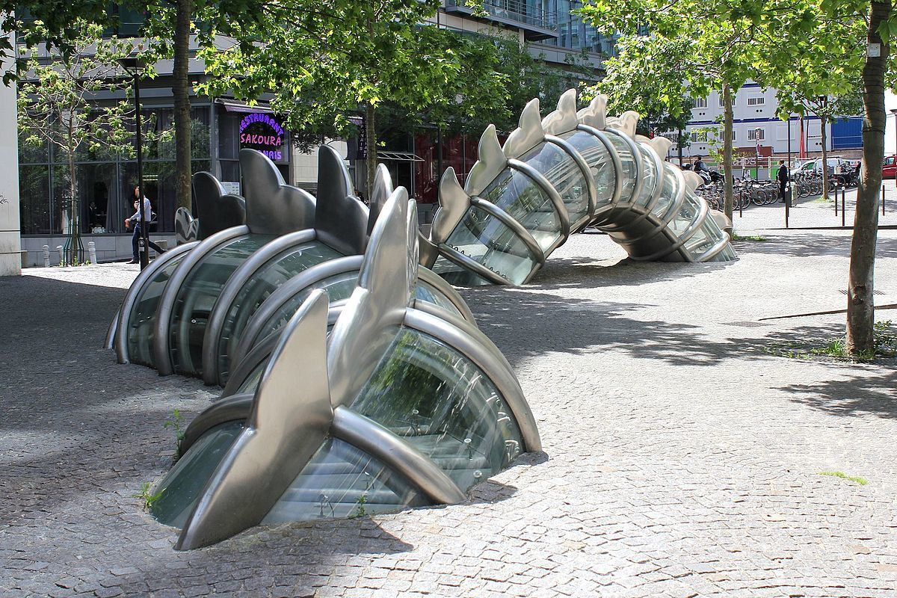
Chen Zhen: La danse de la fontaine émergente ²⁶
Location: Paris
Place Augusta Holmes
Materials:
Stainless steel, glass and plastic
Dimensions:
Weight:
Year created:
2008
The fountain, designed by the French Chinese artist is designed to resemble a dragon winding its way around the square, emerging and submerging from the pavement. The dragon's transparent skin shows the water flowing within.
The fountain is in three parts. An opaque bas-relief dragon appears to emerge from the water-supply plant wall and plunge underground. The transparent second and third parts show the dragon seeming to arch out of the pavement. Water under pressure flows within and is illuminated at night. The fountain was commissioned by the City of Paris in 1999 and inaugurated on February 6, 2008. Although the artist died in 2000, he left sketches showing how the fountain should look like and was completed by Xu Min, the sculptor's spouse and collaborator. The fountain did cost 1,2M€, largely financed by the City of Paris and the Ministry of Culture of France.
Sources: Wikipedia and https://www.parisladouce.com/2013/03/paris-la-danse-de-la-fontaine-emergente.html

Slide 21
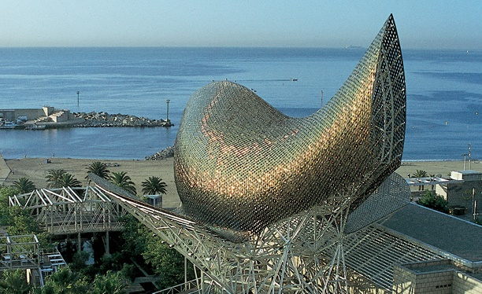
Location: Barcelona, Spain
Material: stainless steel
Dimensions: H 38m L: 58m
Weight: unavailable
Year created: 1992
Frank Gehry: The golden fish ²⁷
El Peix d’Or is a mesh sculpture in the form of an open-mouthed undulating fish. It is made of stone and steel. Its copper-colored stainless steel scales shine under the Mediterranean sun and change appearance depending on the angle of the sun and the current weather conditions, accentuating the organic form of this vast sculpture.
The Golden Fish called El Peix d’Or in Catalan, was designed for Barcelona’s 1992 Olympic village and port. The golden coloured steel structure serves as a canopy for the commercial area which links the luxurious Hotel Arts to the seafront near the Olympic Marina. It is one of the best-loved and most striking iconic landmarks on Barcelona’s seafront. http://www.barcelonaturisme.com/wv3/en/page/1232/peix-fish-frank-gehry.html

Slide 22
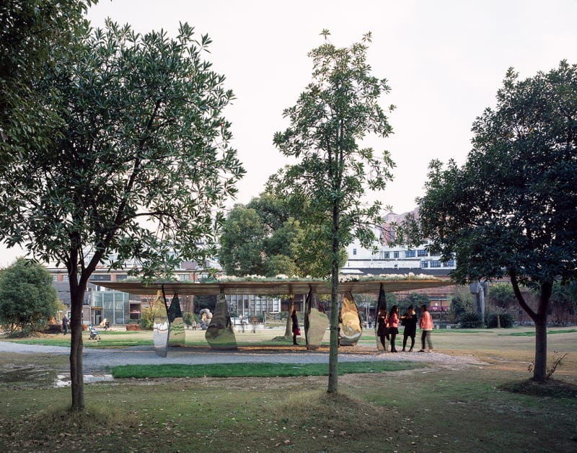
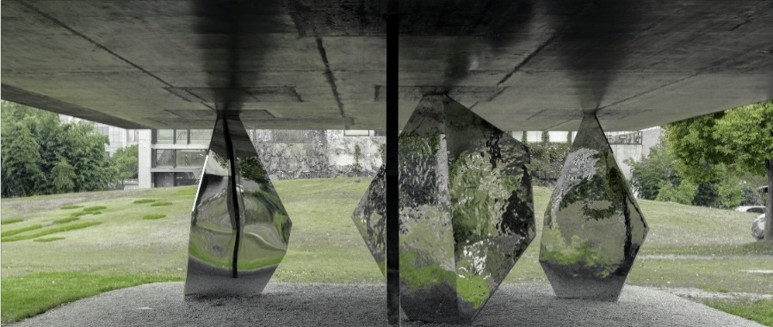
Location: Shanghai, China
Material: stainless steel
Dimensions: H 8m L: 12m
Weight: unavailable
Year created: 2015
Zhan Wang + Atelier Deshaus: Blossom Pavilion ²⁸
The starting point for the project was the stainless steel sculptures of Zhan Wang's Rockery Series, which the artist has been working on since 1995. Atelier Deshaus reinterpreted these forms as structural elements, aiming to create a pavilion modelled on a rock garden. Six slender rock-shaped columns support a solid steel roof, which is topped by plants and flowers. The reflective columns are arranged randomly, rather than at the most structurally efficient points, to reinforce the idea of a rockery.
https://www.archdaily.com/792211/blossom-pavilion-atelier-deshaus/5799b693e58ece81bd00004a-blossom-pavilion-atelier-deshaus-photo

Slide 23
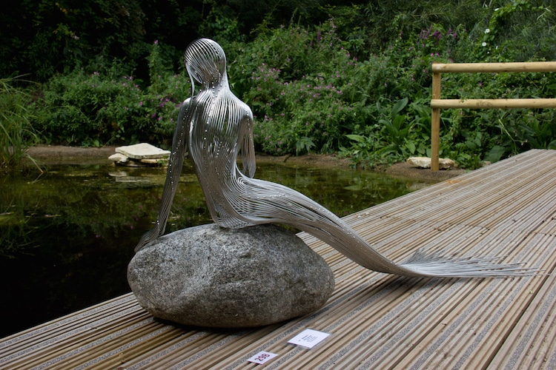
Material: stainless steel
Dimensions: lifesize
Weight: unavailable
Year created: -
Martin Debenham: mermaid 3 ²⁹
British contemporary sculptor Martin Debenham creates stainless steel wire sculptures inspired by fantasy and nature. Working with a malleable material that has endless potential, the self-taught artist’s growing collection of wire art features impressive structures rendered from intricate twists, bends, and expert welding.
Appearing as though they’re three-dimensional line drawings, most of Debenham’s metal masterpieces are made for outdoor display. When placed into natural environments, they seem to evoke mythical narratives as they glimmer in the sunlight. For example, in one piece, a wire-sculpted mermaid sits on a rock by a lily pond, positioned as though she’s contemplating going for a swim. Each strand of wire is sculpted into curves that follow the form of the female body, then flow into a long mermaid tail.
https://mymodernmet.com/wire-sculptures-martin-debenham/

Slide 24
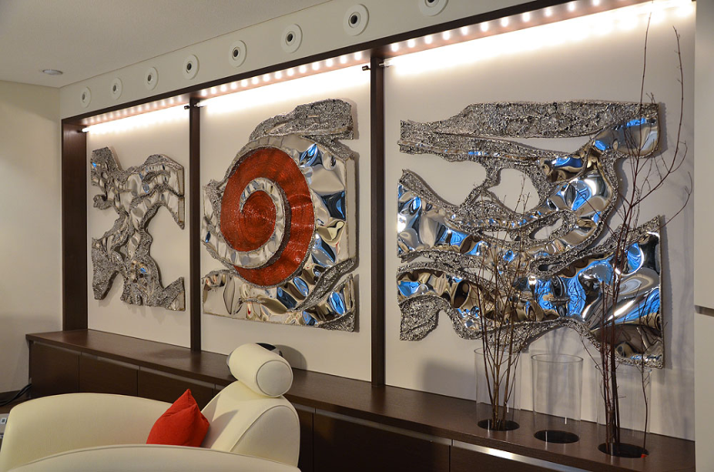
Robert Gahr: Surge ³⁰
Location:
Material:
polished & colored stainless steel
Dimensions:
3 panels of 1mx1m each
Weight:
Year created:
2011
Wall Sculpture

Slide 25
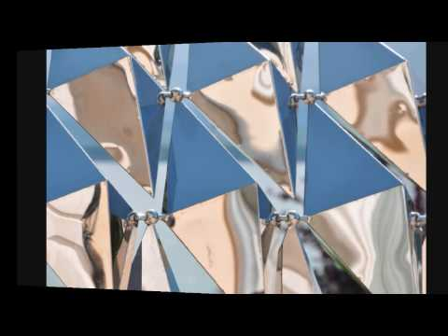
Ralfonso Karo: #1 Kinetic Wind Sculpture ³¹
Location:
Material:
Dimensions:
2.1m tall
Weight:
Year created:
25 diamond shaped stainless steel elements connect, self-balance and move independently in the wind. Click here for video (4’:51’’)

Slide 26
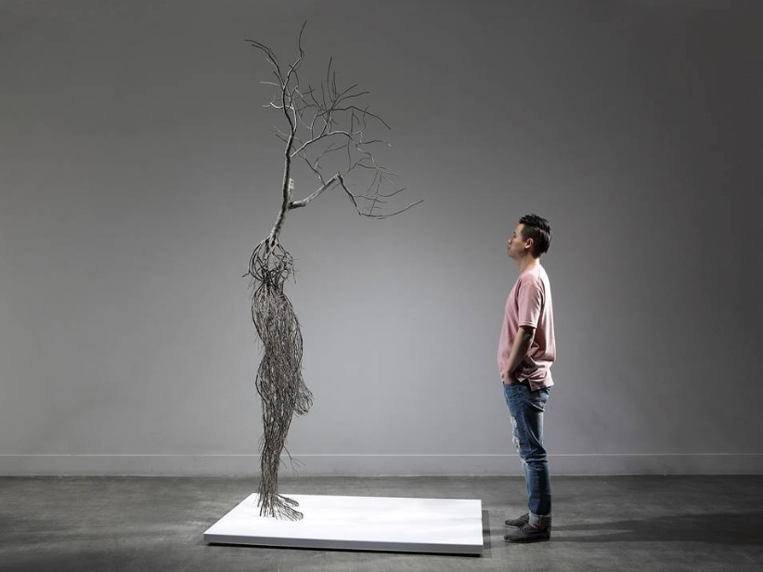
Sun Hyuk Kim: Forgotten Memory ^{32, 33}
Location: S. Korea
Materials: painted stainless steel
Dimensions:
273x160x95cm
Weight:
Year created:
2017
NEW 2019!
Artist Sun-Hyuk Kim takes inspiration from complex root systems found in nature to construct the human form. Each sculptural figure sprouts a branch or sometimes a small tree, appearing to be some type of human-botanic hybrid. The large, stainless steel sculptures feature fragments of faces, headless bodies, and figures crouching towards the ground as if they are overcome by a great weight on their backs.
Kim’s minimalist sculptures allow us to project ourselves onto each of his pieces. They communicate fragility. We all know how it feels to be pulled in different directions and the often-uncomfortable state of growth and change. But in having this knowledge, it connects us together and reminds us that the human experience is vast and ever-changing—just like that of a tree.

Slide 27
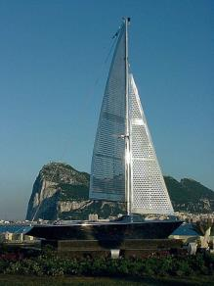
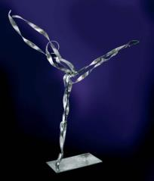
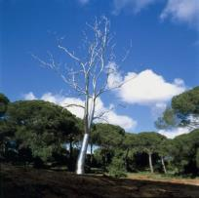
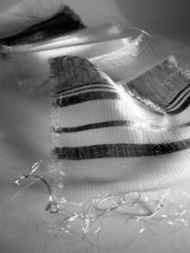
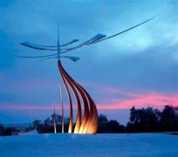
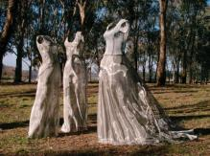
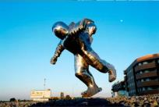
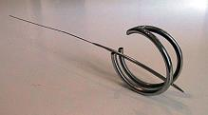
And there is a lot more !
http://www.worldstainless.org/applications/art
If you have other remarkable works of art in mind, please let us know!

Slide 28
References (1/3)
UPDATED 2019!
http://www.andyscottsculptor.com/
http://en.wikipedia.org/wiki/The_Kelpies
http://atomium.be/
http://en.wikipedia.org/wiki/Atomium
http://www.gatewayarch.com/
http://en.wikipedia.org/wiki/Gateway_Arch
http://www.cityofchicago.org/city/en/depts/dca/supp_info/millennium_park_-artarchitecture.html
http://en.wikipedia.org/wiki/Cloud_Gate
http://saintluciasculpturepark.com/portfolio/anilore-banon/
http://www.war-memorial.net/The-Braves---Les-Braves-1.292
https://www.youtube.com/watch?v=yHkOQWPZhyM
https://jaumeplensa.com/works-and-projects/public-space/mirror-2012
https://www.theguardian.com/artanddesign/2011/mar/30/jaume-plensa-show-at-yorkshire-sculpture-park
https://www.theguardian.com/arts/gallery/2007/oct/03/spider
http://www.eilahiltunen.net/monument.html

Slide 29
References Art (2/3)
UPDATED 2019!
http://monicabonvicini.net/work/she-lies/
http://anishkapoor.com/111/turning-the-world-upside-down
https://www.gpsmycity.com/attractions/sun-voyager-28054.html
http://twistedsifter.com/2014/07/wire-fairy-sculptures-by-robin-wight/
http://megaconstrucciones.net/?construccion=cristo-chiapas
http://joanavasconcelos.com/det_en.aspx?f=2393&o=933
http://www.jeffkoons.com/artwork/celebration/sacred-heart
http://www.bruvel.com/exhibitions/houston-art-fair-2015
http://twistedsifter.com/2011/10/metalmorphosis-sculpture-david-cerny/
https://www.dailyscandinavian.com/the-worlds-biggest-elk-statue-in-norway/
https://www.parisladouce.com/2013/03/paris-la-danse-de-la-fontaine-emergente.html
http://www.barcelonaturisme.com/wv3/en/page/1232/peix-fish-frank-gehry.html
https://www.archdaily.com/792211/blossom-pavilion-atelier-deshaus/5799b693e58ece81bd00004a-blossom-pavilion-atelier-deshaus-photo

Slide 30
References Art (3/3)
UPDATED 2019!
https://mymodernmet.com/wire-sculptures-martin-debenham/
http://www.gahr-metalart.com/artworks/metal_wall_art.htm
http://www.ralfonso.com
https://mymodernmet.com/sun-hyuk-kim-stainless-steel-sculptures/
https://www.sunhyuk.com/sculpture

Slide 31
Thank you!
Test your knowledge of stainless steel here:
https://www.surveymonkey.com/r/3BVK2X6

